Slide 1
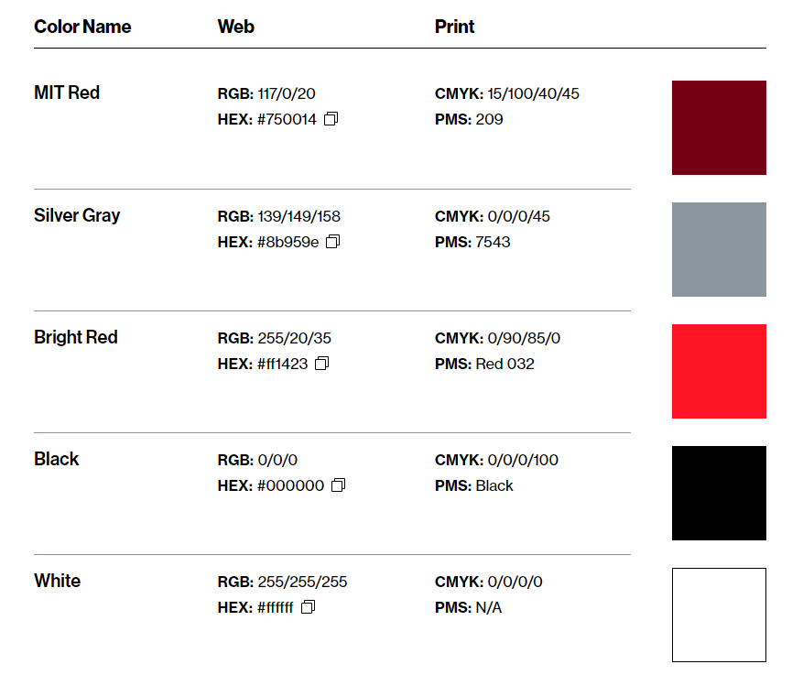
Machine Learning Examples in 2D Material Development
Dimension:2.4, 31.5
Position: 1, 0.5
Machine-Learning-Driven Numerical Analysis of SEM Images
for Optimizing MOCVD-Grown MoS₂ Device Performance
Collaboration - 02 Meng-Chi (Ed) Chen NMEG, 2025-01-29
△
Recipe Optimization
Recipe
SEM Image Numerical Representation
Coverage calculation ✓
Scale mark extraction ✓
Average grain size calculation ✓
Nucleation density calculation ✓
Circumference calculation ✓
Background noise representation ✓
Synthesis
Sample
Characterization
✓
SEM Image
Computer Vision
Analysis
Fabrication
Device
Measurement
Prediction
△
Performance
Notes:
The exploration of two-dimensional (2D) materials for next-generation semiconductors begins with recipe optimization to synthesize high-quality 2D materials
, followed by characterization such as optical microscopy, Raman spectroscopy, atomic force microscopy (AFM), and scanning electron microscopy (SEM).
Samples with promising quality proceed to device fabrication and performance testing.
From experience, we (Jiadi) find that scanning electron microscopy (SEM) images strongly correlate with device outcomes.
However, a systematic numerical description of SEM results is lacking.
Here, we present an algorithm that leverages machine learning and computer vision to provide a numerical representation (NR) of SEM images of 2D MoS₂, correlating this NR with device performance and using the desired NR for recipe optimization .
This research is ongoing, with a green checkmark indicating completed functions and a yellow triangle highlighting areas still under development.
Today, I would like to show you the current stage of this project.

Slide 2
Project Control Table
Dimension:3, 31.8
Position: 1, 0.5
Content | Brief | Type | Link
TMD CV Analysis | SEM data | Dropbox | https://www.dropbox.com/scl/fo/36wrwwr47m0vifwe8wvnu/AF0F0pOW3Z0kwe34LtRxTuM?rlkey=2v16wbs3bq6vu81e4fph4nnok&st=ibc5brxd&dl=0
MoS2 Material and Performance Characterization | Exp recipe | Google Sheet | https://docs.google.com/spreadsheets/d/1oJ1RdsqrisFb9jxFJyc4TyQTLStmKBVbRIwYu-NxrmI/edit?usp=sharing
 |  | .docx
2024-0828_SEM Image Seg | Presentation | .pptx | https://mitprod-my.sharepoint.com/:p:/g/personal/edchen93_mit_edu/EeBhIB1nFoVAlkqaQcClEtsBsYqwneUawGiF3oEFSIJpbg?e=pXUIMv
.

Slide 3
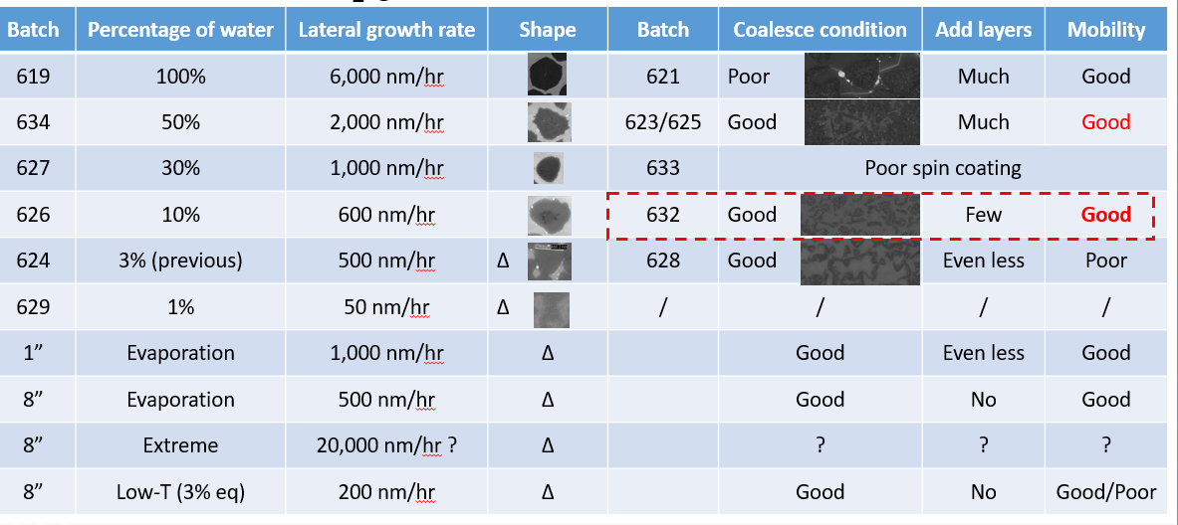
1 hr
3 hr
NA.
Ignore
Notes:
2024-12-02
Consider other factors.

Slide 4
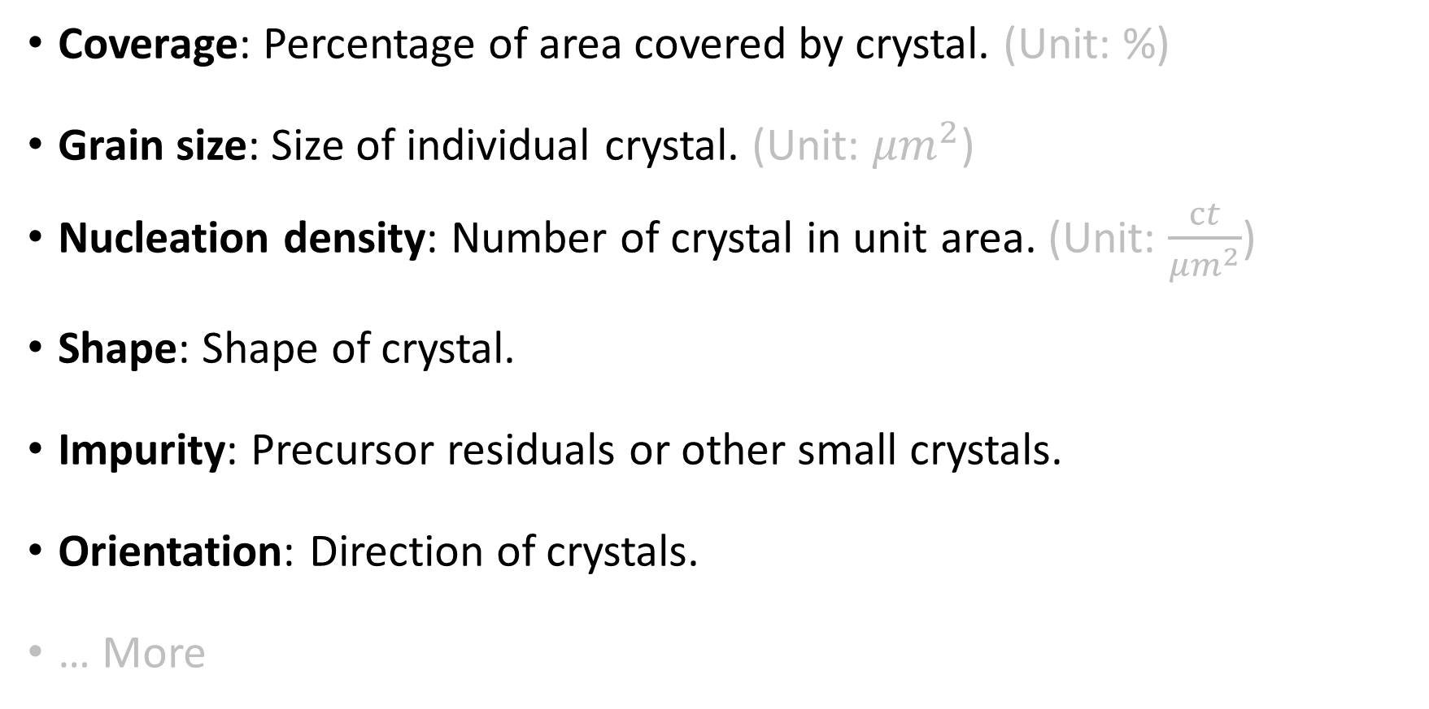
How to describe an SEM image of a 2D material?
Dimension:3, 31.8
Position: 1, 0.5
Coverage: Percentage of area covered by crystal. (Unit: %)
Grain size: Size of individual crystal. (Unit: ${μm}^{2}$)
Nucleation density: Number of crystal in unit area. (Unit: $\frac{ct}{{μm}^{2}}$)
Shape: Shape of crystal.
Impurity: Precursor residuals or other small crystals.
Orientation: Direction of crystals.
… More
Notes:
How do we usually describe an SEM image of a 2D material?

Slide 5
How to get these information?
Dimension:3, 31.8
Position: 1, 0.5
ImageJ (or other scientific software for microscopic image processing)
  Require multiple steps of settings and adjustments.
  Some of our desired function are not exist (or require excessive post process).
Python
  Customize the field-specific needs.
  Streamline the process.

Slide 6
Execution Steps
Dimension:3, 31.8
Position: 1, 0.5
Numerical Representation
Extract scale bar info from SEM image.
Convent SEM image to grayscale.
Crop out the center square.
Enlarge image for better CV processing (cv2.INTER_LINEAR).
Slightly blur the image (cv2.medianBlur(k=5)).
Enhance image (CLAHE and merge).
Binarize image with Otsu's method.
Calculate coverage and create histogram.
Watershed image.
Segment image and save segmentations.
Calculate segmentation result.
Save result as excel.
Pixel per um (sclbar_text, pixel_length_sclbar, pixels_per_um).
Coverage (pct_black, pct_white).
Segmentation (cnt_seg_success)
Nucleation density (nd_per_sqnm)
Grain size (avg_gs_squm, std_gs_squm)
Circumference (avg_circumf_um, std_circumf_um)
Cricumference square to area ratio (avg_csar, std_csar)
Background noise (avg_bkgd_pixel, std_bkgd_pixel)
enh_cliplmt=2, enh_tileGrid=8

Slide 7
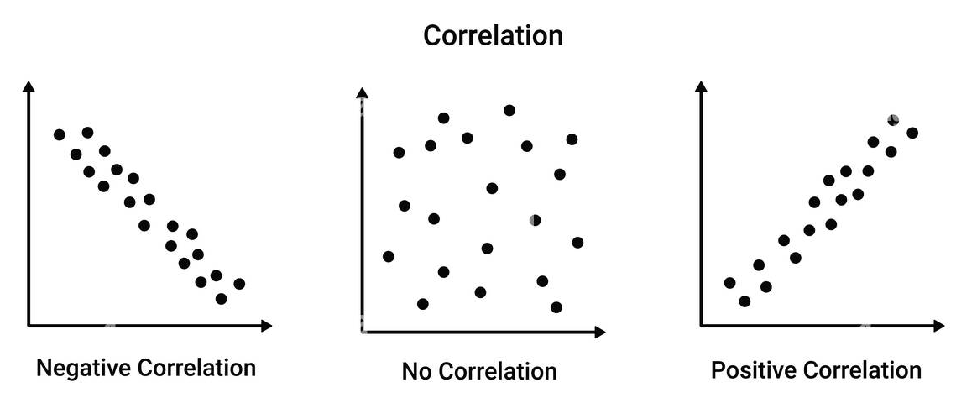
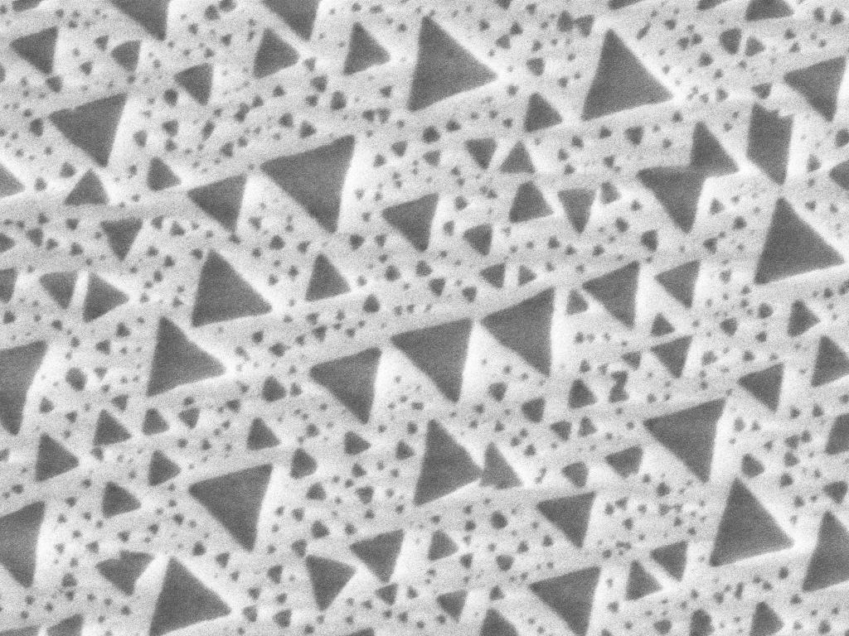

How are these measurements relating to devise performance?
Dimension:3, 31.8
Position: 1, 0.5
Numerical representation
of 2D material SEM images:
Pixel per um (sclbar_text, pixel_length_sclbar, pixels_per_um).
Coverage (pct_black, pct_white).
Segmentation (cnt_seg_success)
Nucleation density (nd_per_sqnm)
Grain size (avg_gs_squm, std_gs_squm)
Circumference (avg_circumf_um, std_circumf_um)
Cricumference square to area ratio (avg_csar, std_csar)
Background noise (avg_bkgd_pixel, std_bkgd_pixel)
It might be harder to see the relation of one single measurement relates directly to the device performance.
Device
Performance
ML model can help correlate measurements from SEM image to device performance when there is more data.

Slide 8
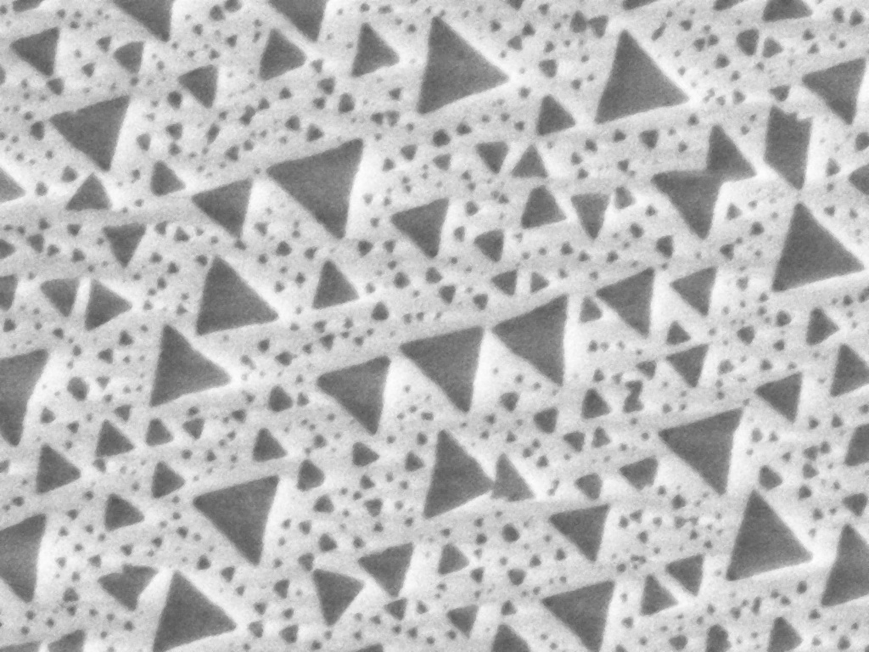
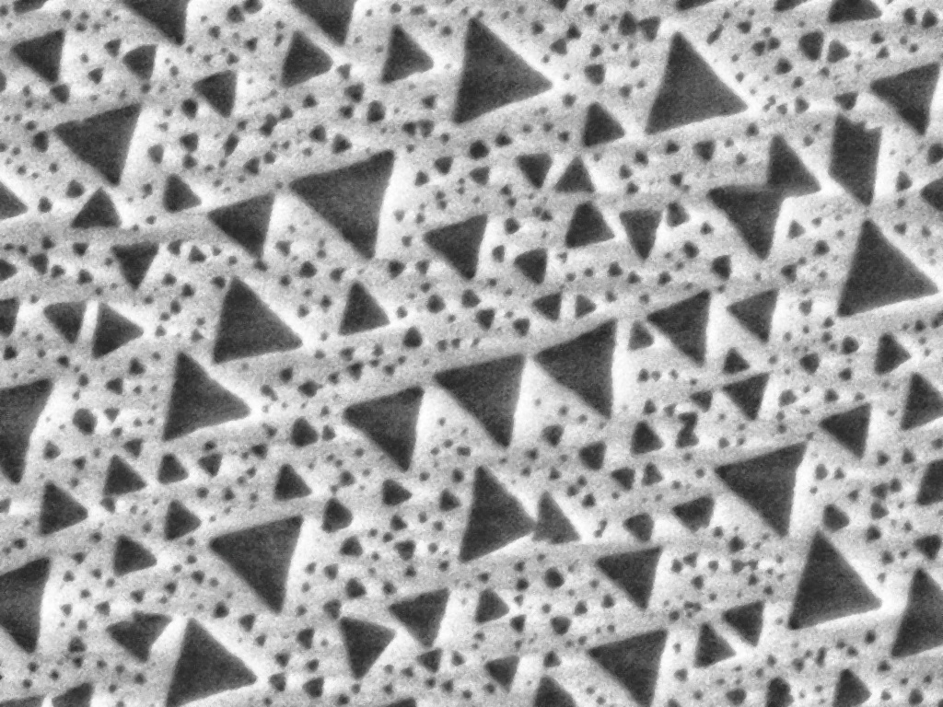
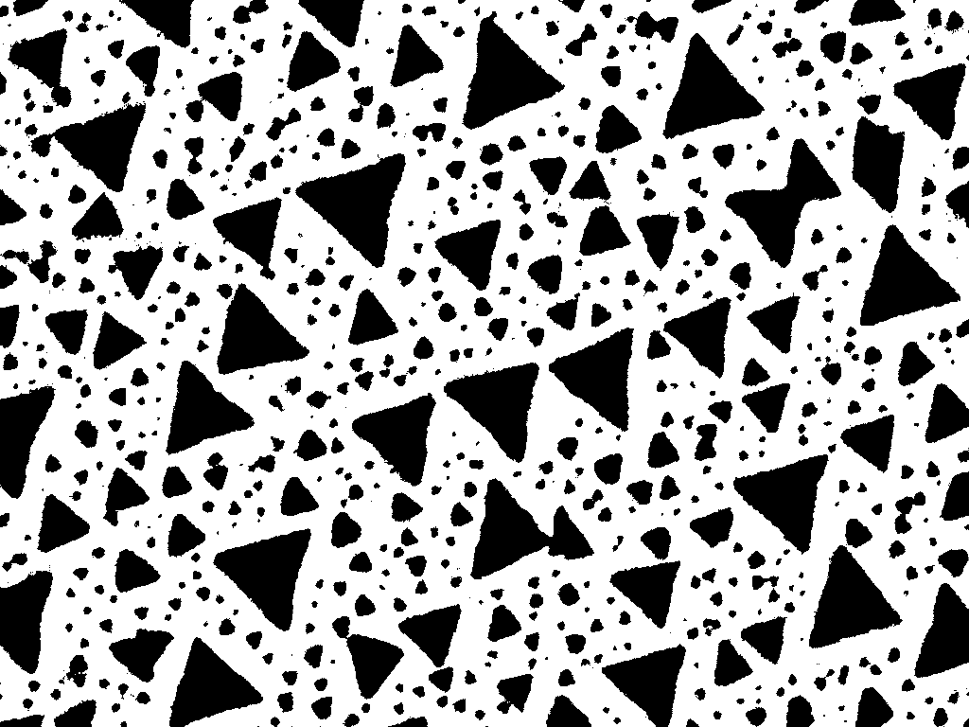
Demo Video
Dimension:3, 31.8
Position: 1, 0.5
Single folder SEM image segmentation.
Took 2 mins to process 4 images.
[OneDrive] Image Seg Demo_480p.mp4
[Local] Image Seg Demo_1080p.mp4
Original
Gentle Blurred
Gentle Enhanced
Binarized

Slide 9
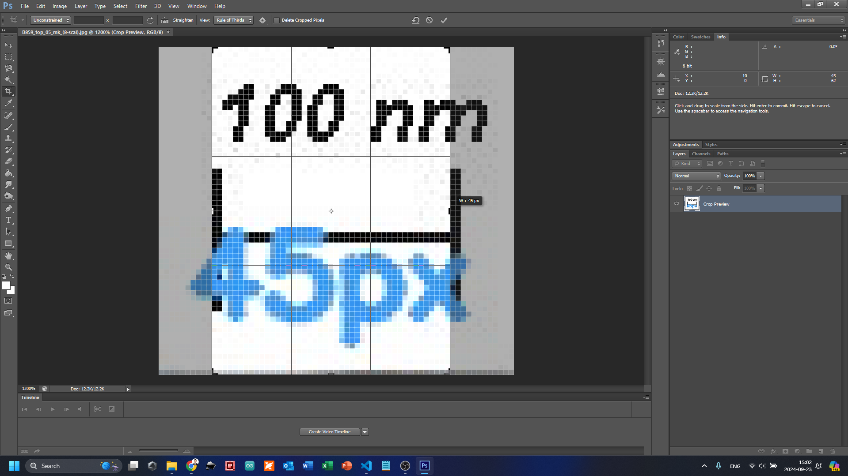
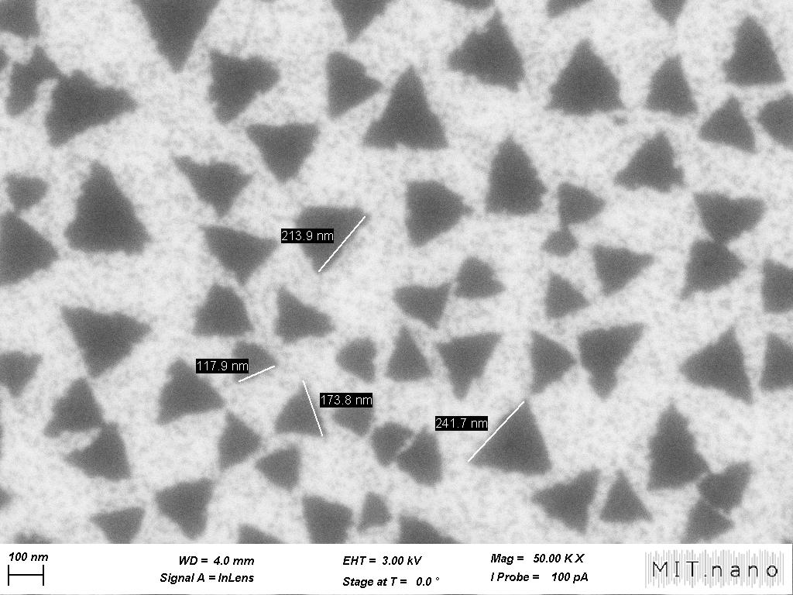
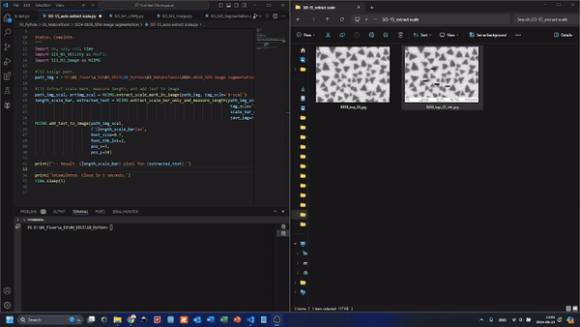
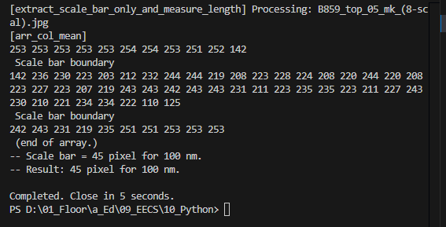
Auto Scale Bar Extraction
Average pixel in columns and rows to cut out desired area of scale bar.
Use pytesseract to read the number of the scale bar.
The length of scale bar matches the actual pixel checked with Photoshop.

Slide 10
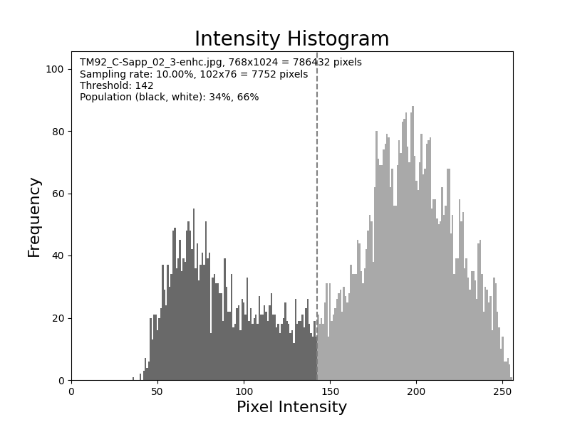

Coverage
Dimension:3, 31.8
Position: 1, 0.5
Original
Gentle Blurred
Gentle Enhanced
Binarized
Original
Gentle Blurred
Gentle Enhanced
Binarized
$$X∈\left\{0, 1, 2, …, 255\right\}$$
Ed: TM92_C-Sapp_02
Otsu's method of thresholding: minimizing the intra-class variance.

Slide 11
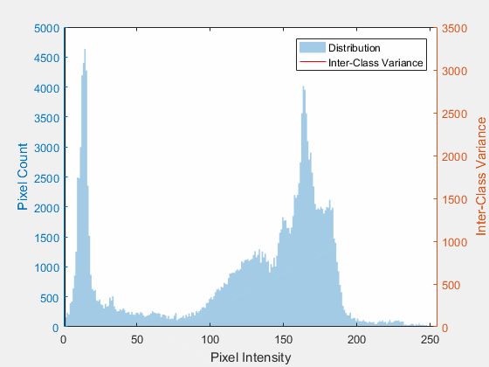
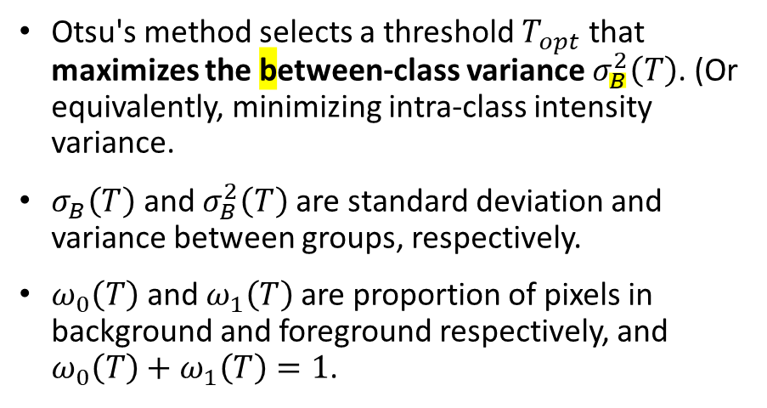
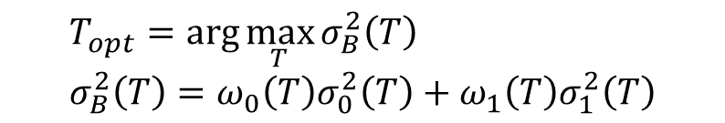
Otsu’s Method
Dimension:3, 31.8
Position: 1, 0.5
$$T_{opt}=\arg{\max_{T}{σ_{B}^{2}\left(T\right)}} \\ σ_{B}^{2}\left(T\right)=ω_{0}\left(T\right)σ_{0}^{2}\left(T\right)+ω_{1}\left(T\right)σ_{1}^{2}\left(T\right)$$
Otsu's method selects a threshold $T_{opt}$ that maximizes the between-class variance $σ_{B}^{2}\left(T\right)$. (Or equivalently, minimizing intra-class intensity variance.
$σ_{B}\left(T\right)$ and $σ_{B}^{2}\left(T\right)$ are standard deviation and variance between groups, respectively.
$ω_{0}\left(T\right)$ and $ω_{1}\left(T\right)$ are proportion of pixels in background and foreground respectively, and $ω_{0}\left(T\right)+ω_{1}\left(T\right)=1$.
otsu_threshold, arrimg_5bnrz \
= cv2.threshold(arr_img, 0, 255, cv2.THRESH_BINARY + cv2.THRESH_OTSU)

Slide 12
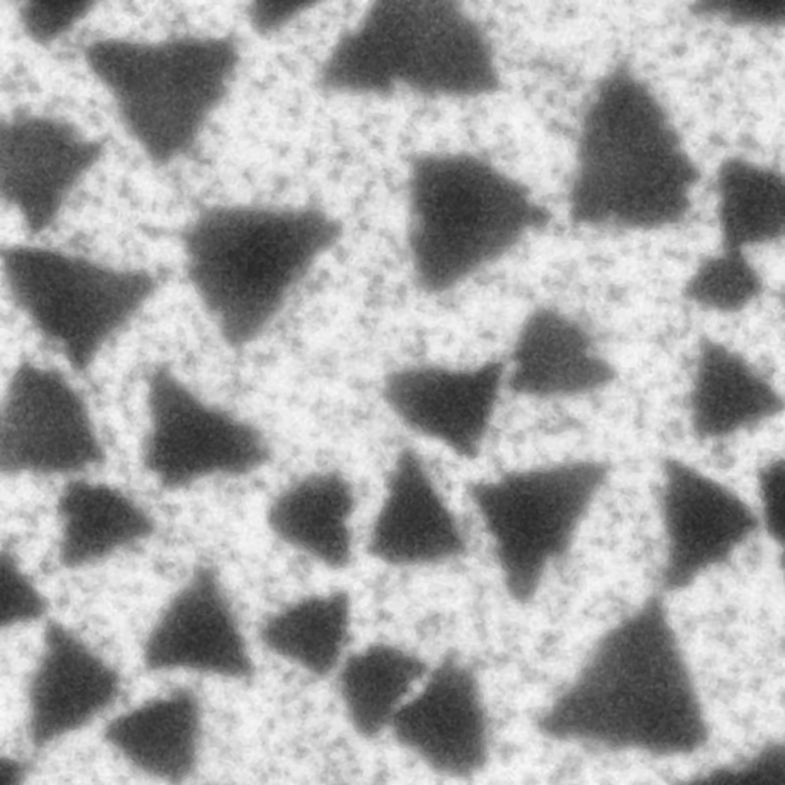
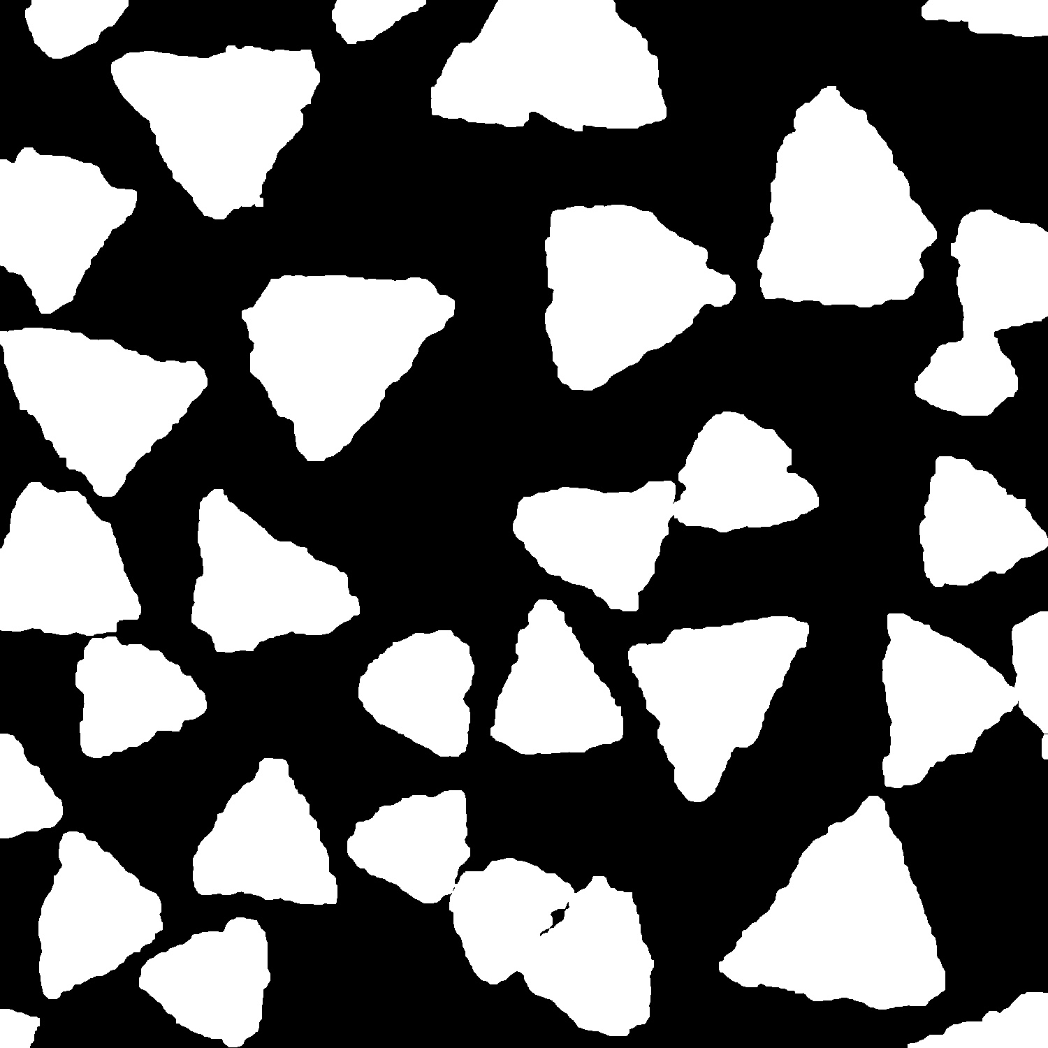
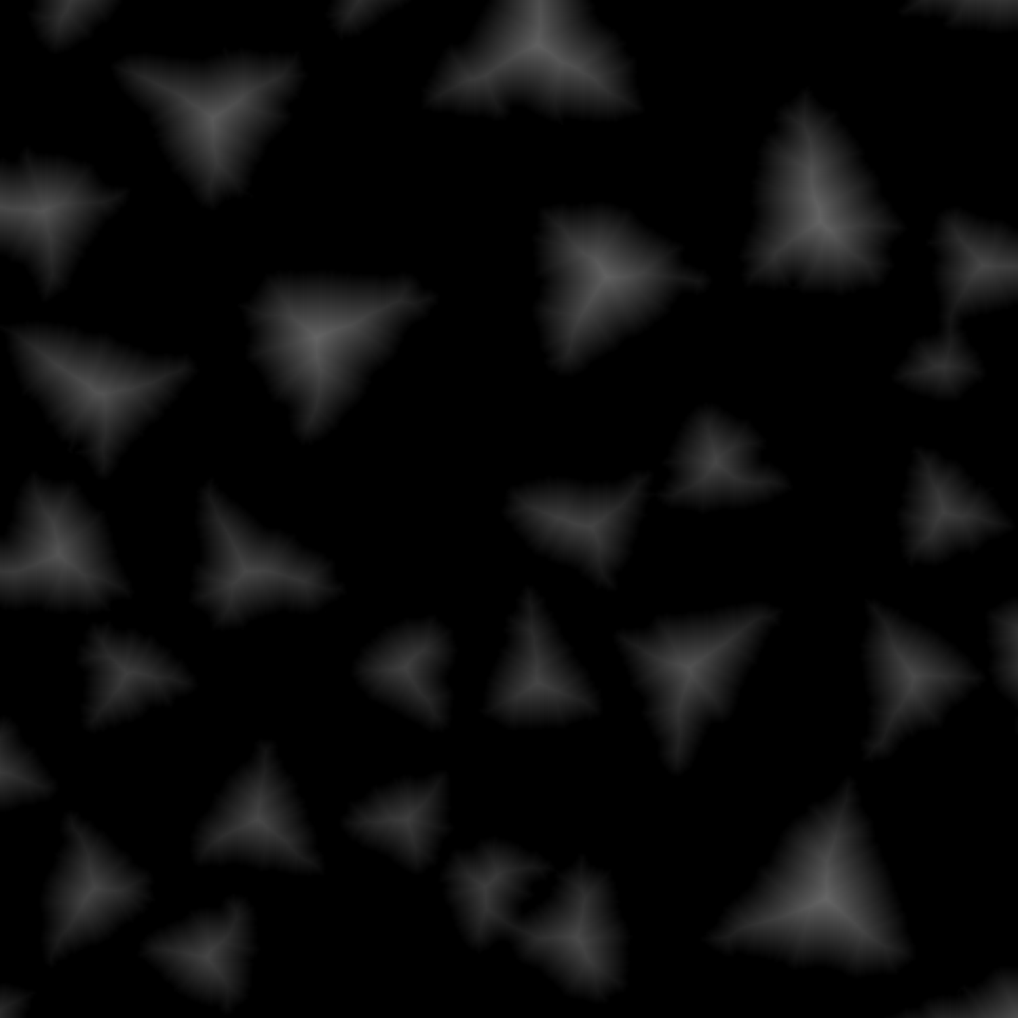
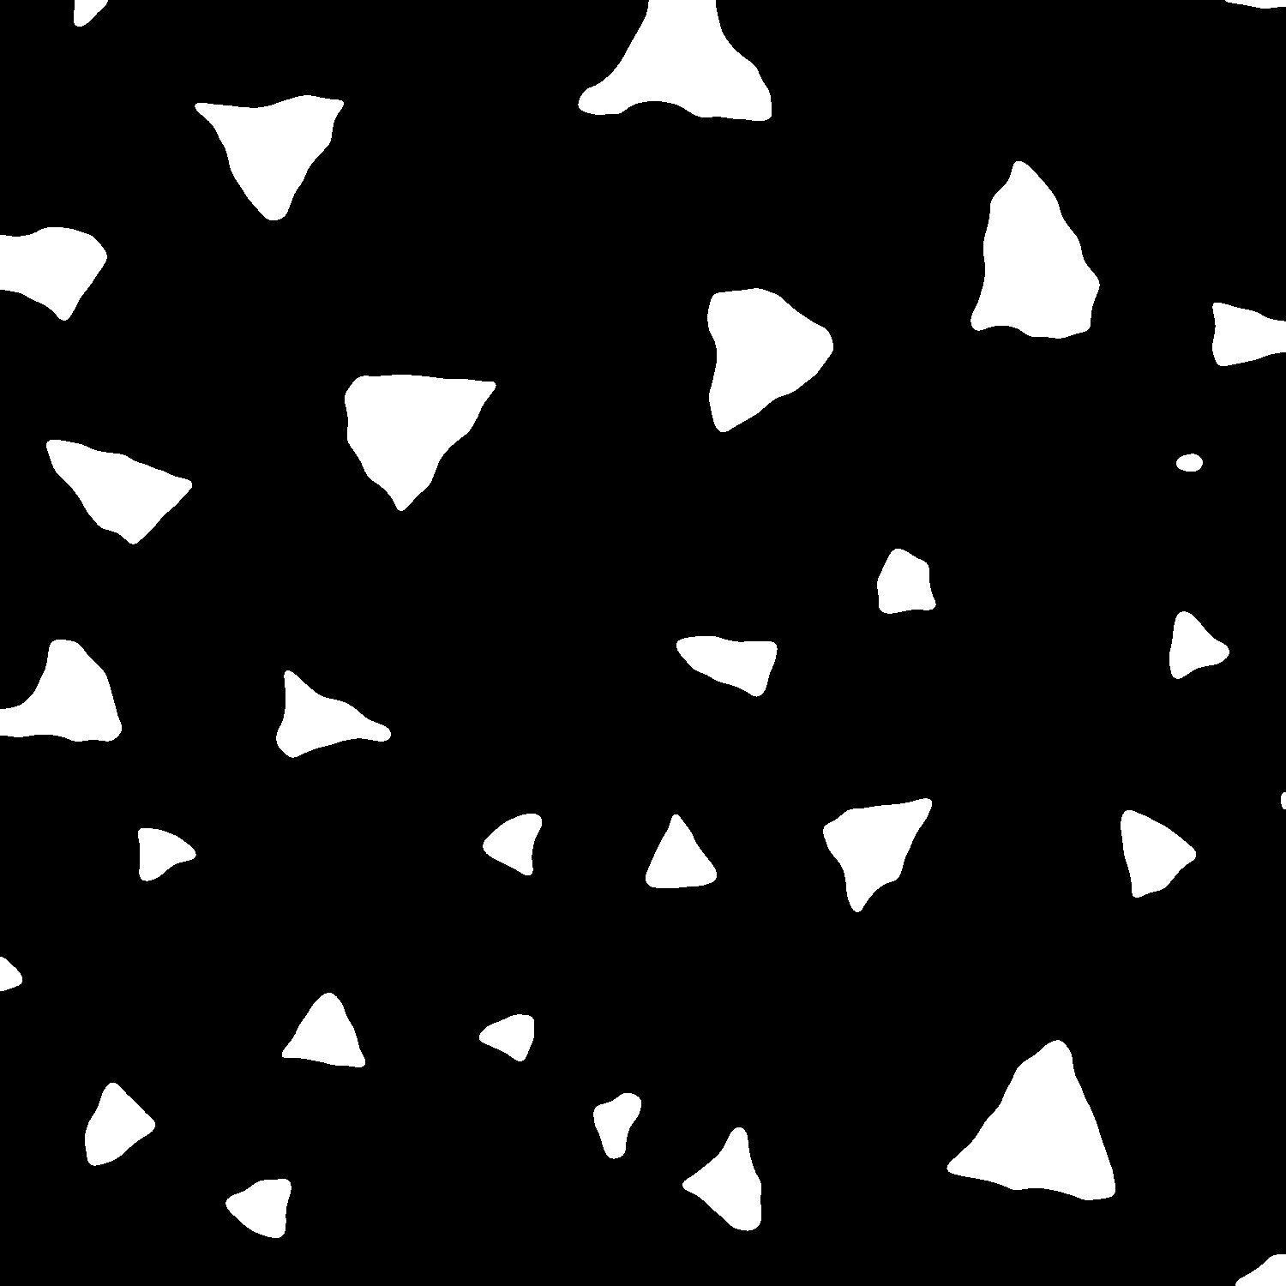
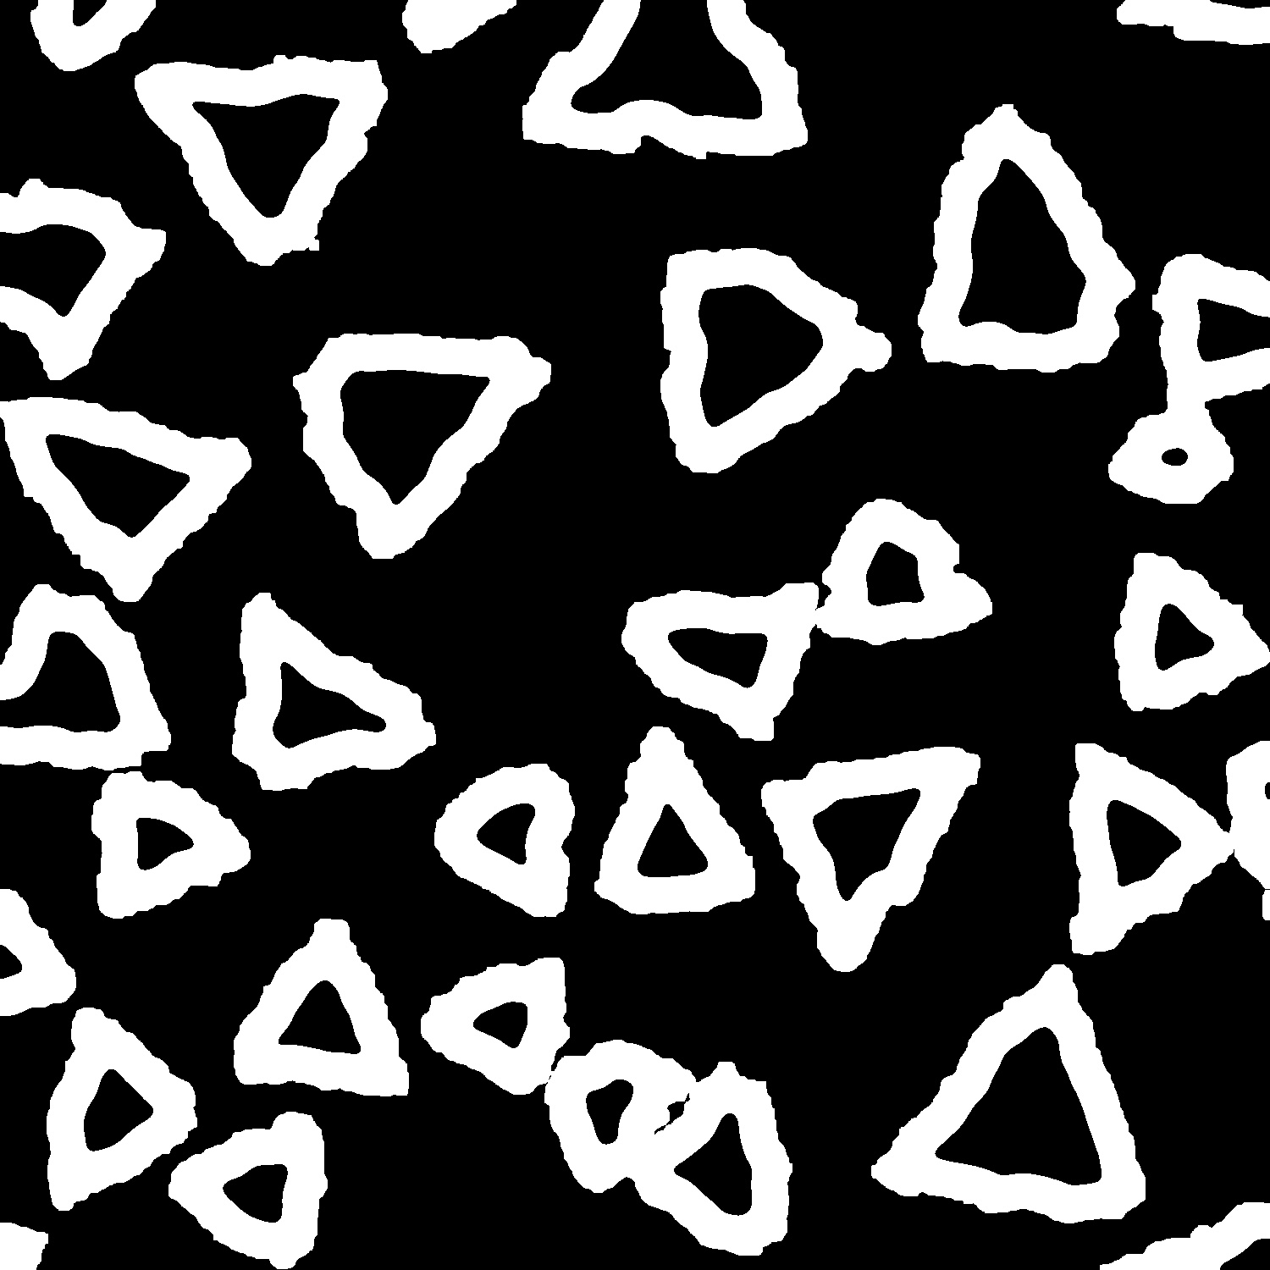
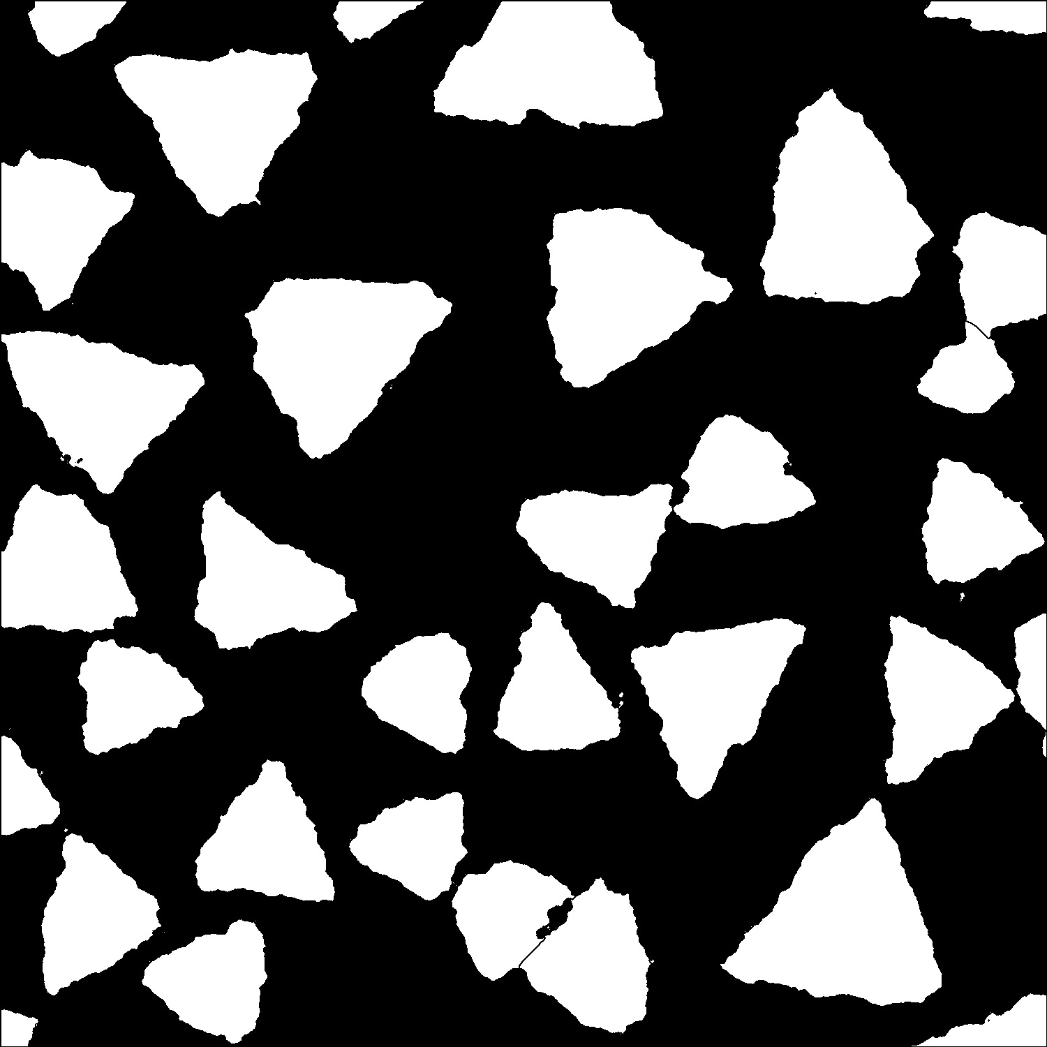
Watershed
Dimension:3, 31.8
Position: 1, 0.5
分水嶺
Cut through crystals that sticks together.
Prepare image: grayscale, noise reduction, then binarize.
Identify background by dilating (extend edge a little bit) the binary image.
Apply distance transform that turn none-zero pixel into the distance to nearest black pixel.
Set threshold to make out foreground from the distance transform result.
Subtract foreground from background to create unknown regions
Apply watershed by flooding between foreground islands to cut though unknown regions.
Prepared image
Background
Distance Transform
Foreground
Unknown
Watershed

Slide 13


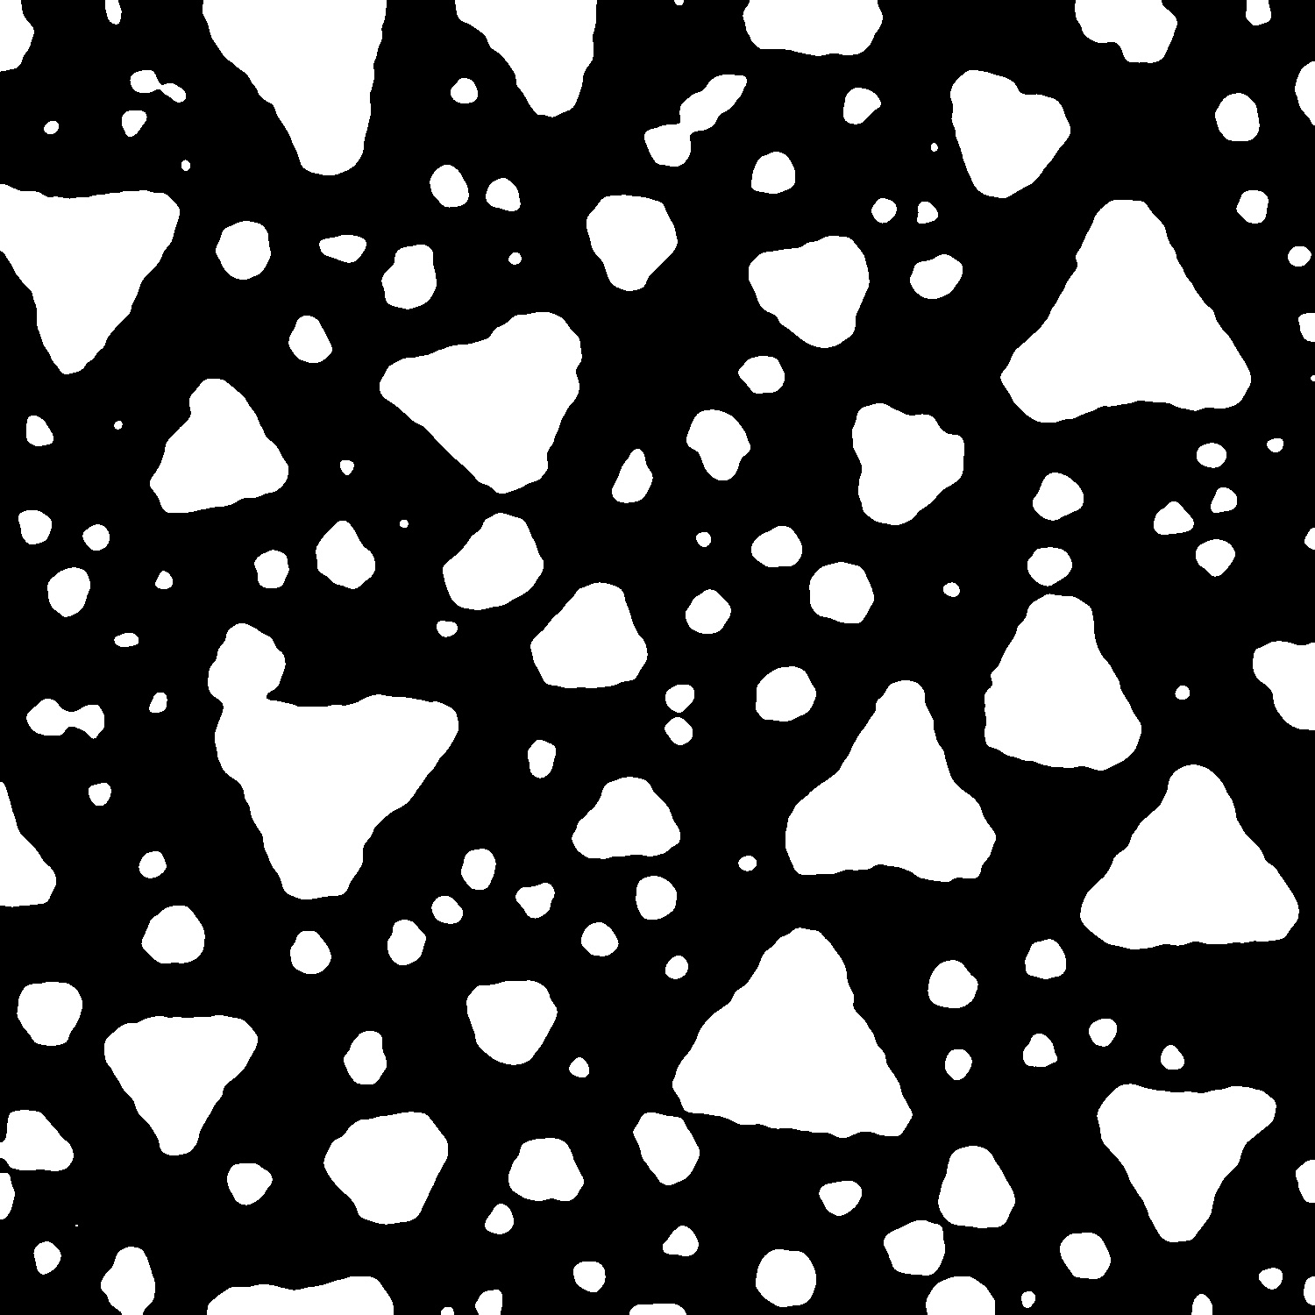

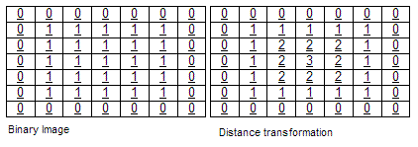
Distance Transform
Dimension:3, 31.8
Position: 1, 0.5
分水嶺
Distance Transform applied to a binary image so that:
Black (0) regions remain black, representing the background.
White (non-zero) regions are transformed so each pixel's value represents the distance (in pixels) to the nearest black (0) pixel.
Input image
After distance transform

Slide 14
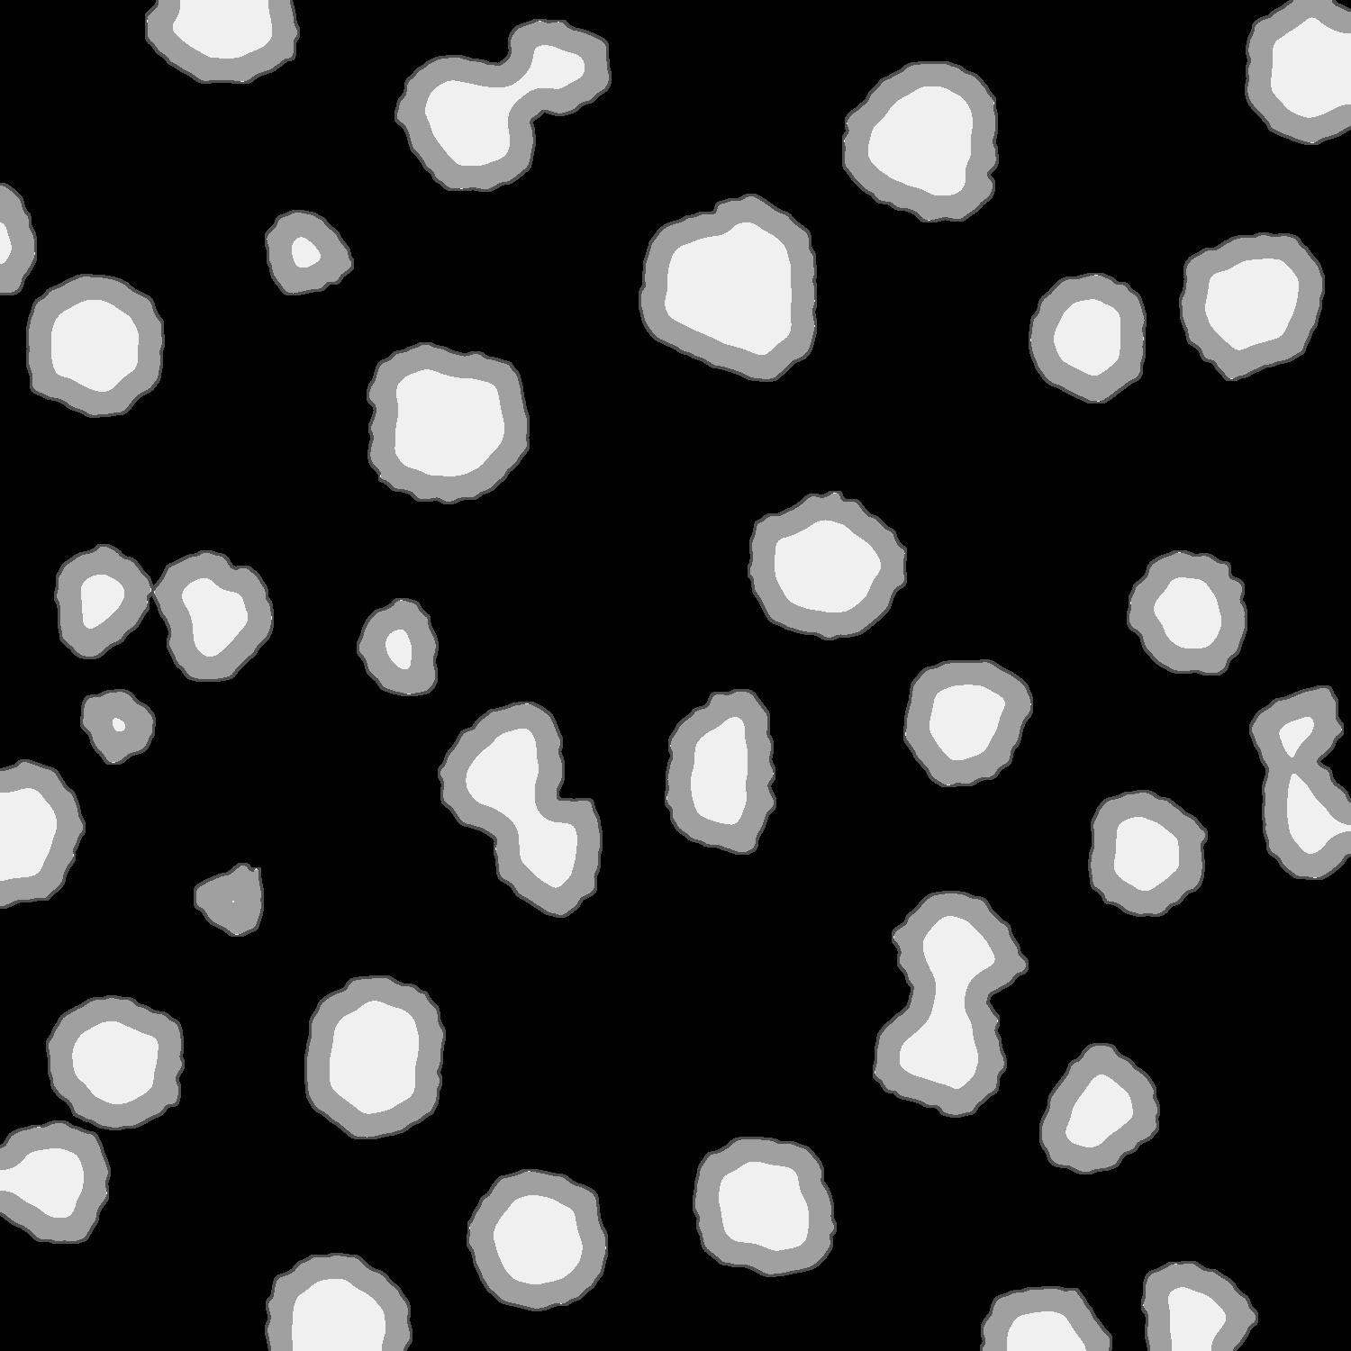
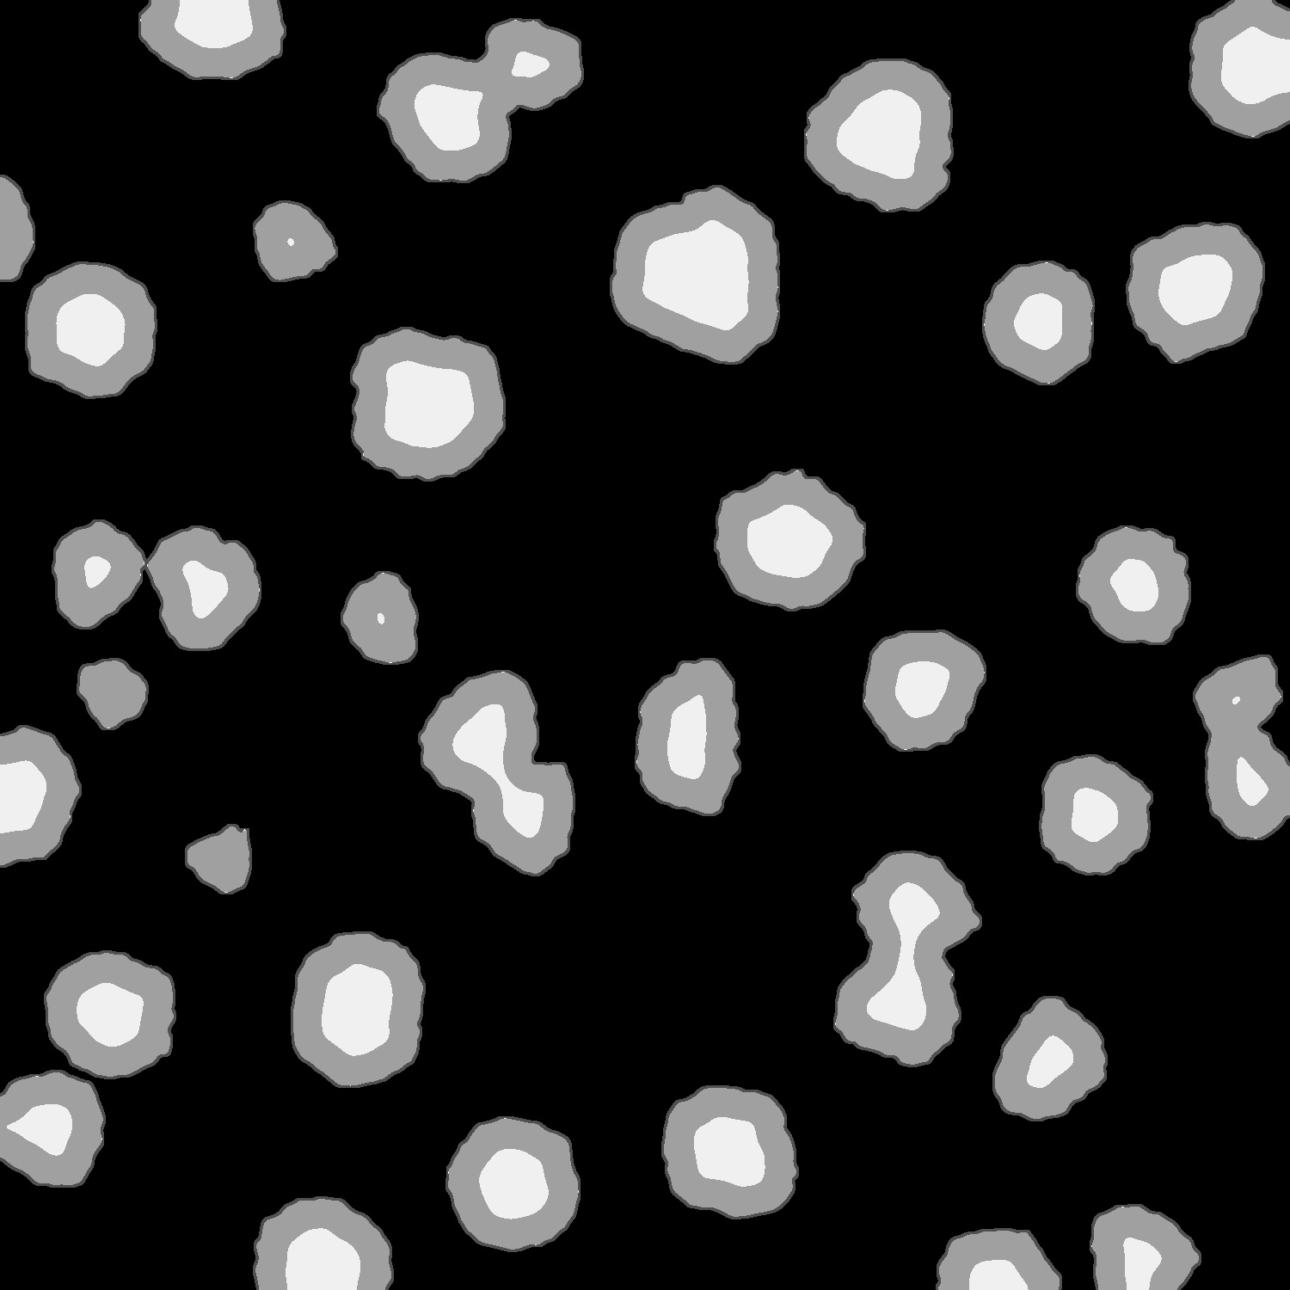
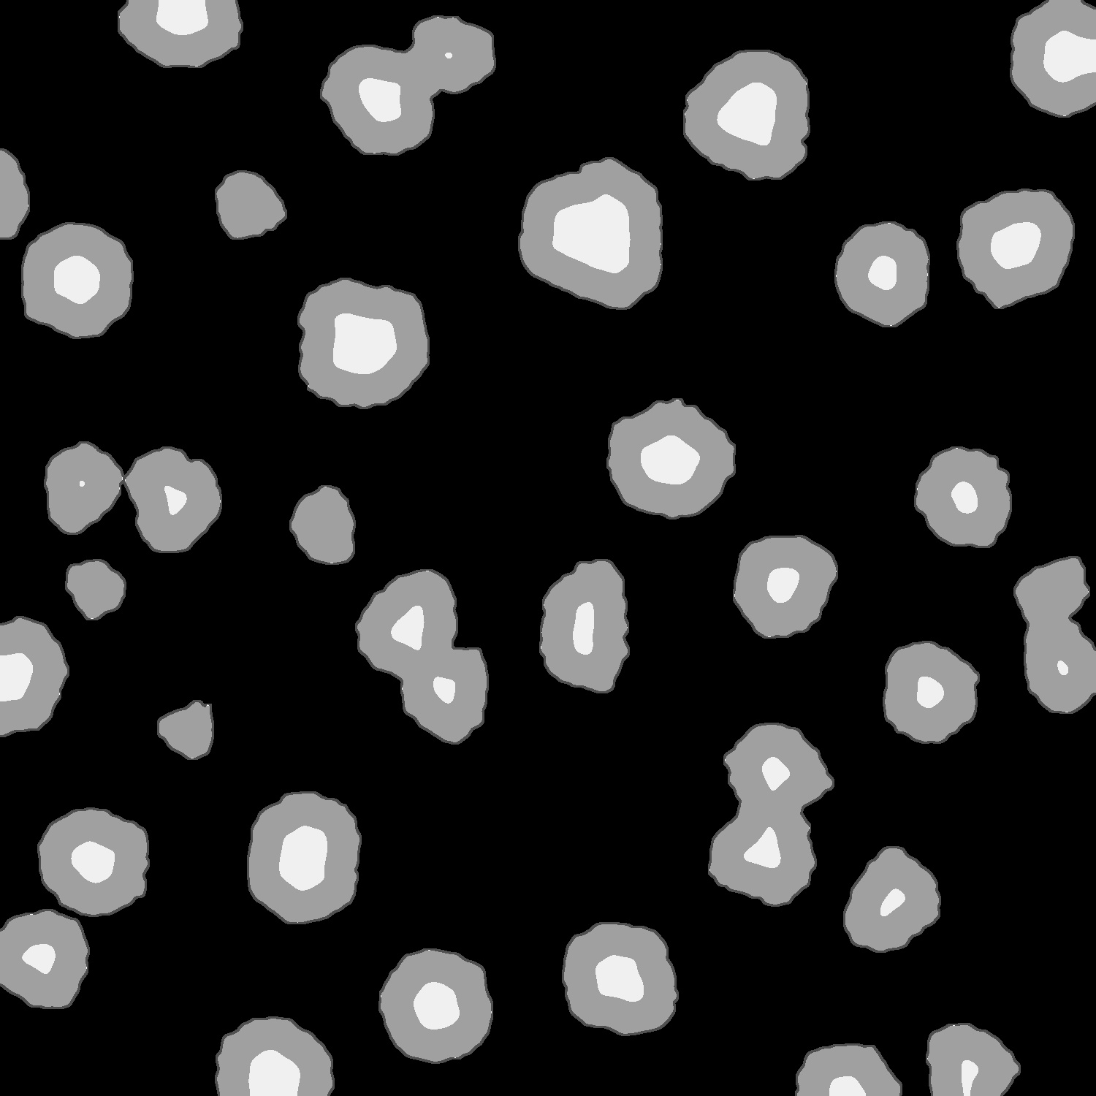
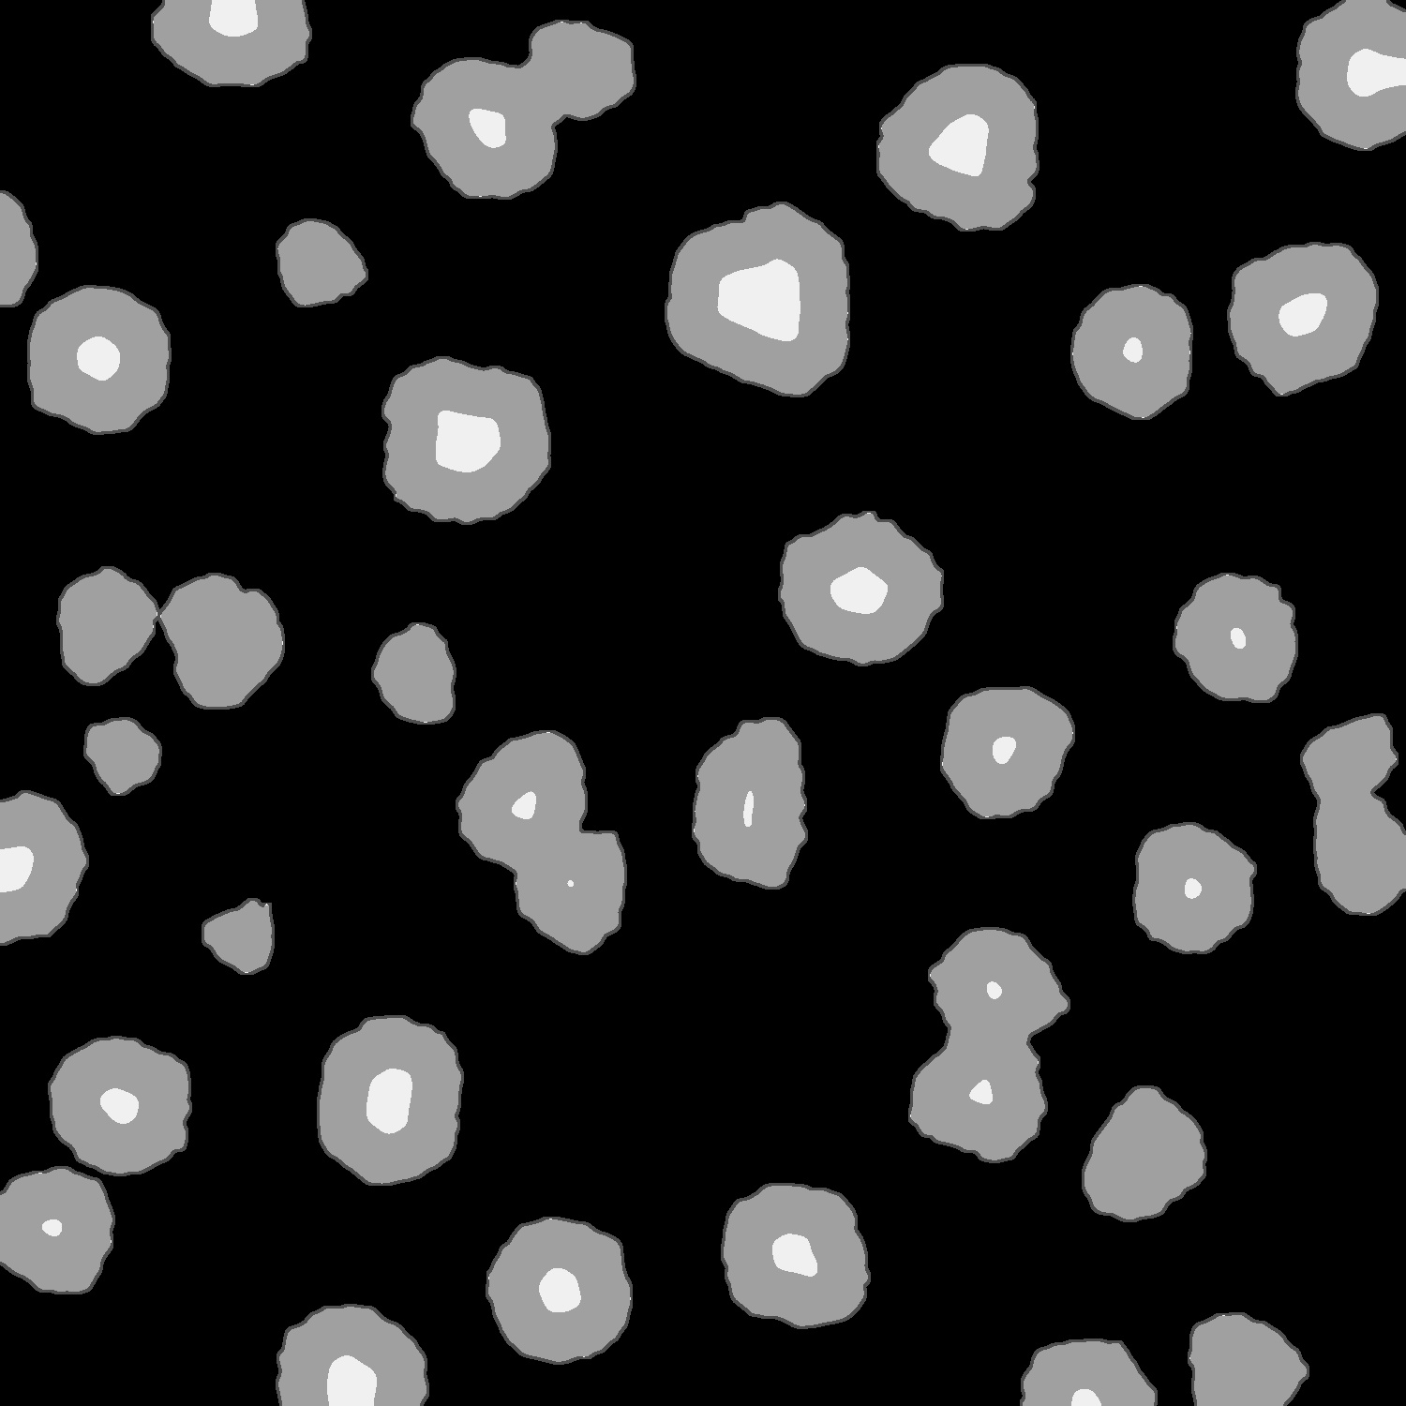
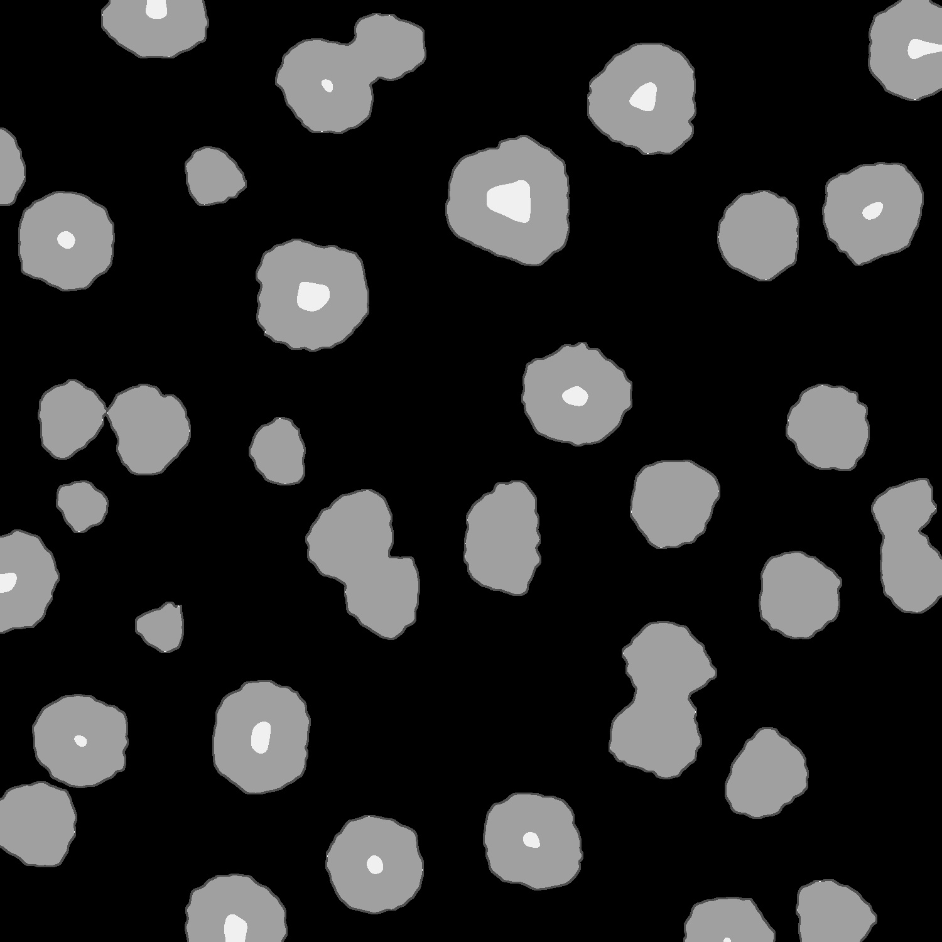

Watershed Parameter Adjustments
Dimension:3, 31.8
Position: 1, 0.5
frgd_thrs_ratio is a parameter between 0 and 1 that controls the erosion from the edge of foreground.
0.3
0.4
0.5
0.6
0.7
Too small, some foregrounds are linked together.
Too high, some foregrounds are missing.
It’s hard to find a middle ground that both error won’t occur.
Setting suitable for this image might not be suitable for another image.
Linked error
Missing error
0.45

Slide 15
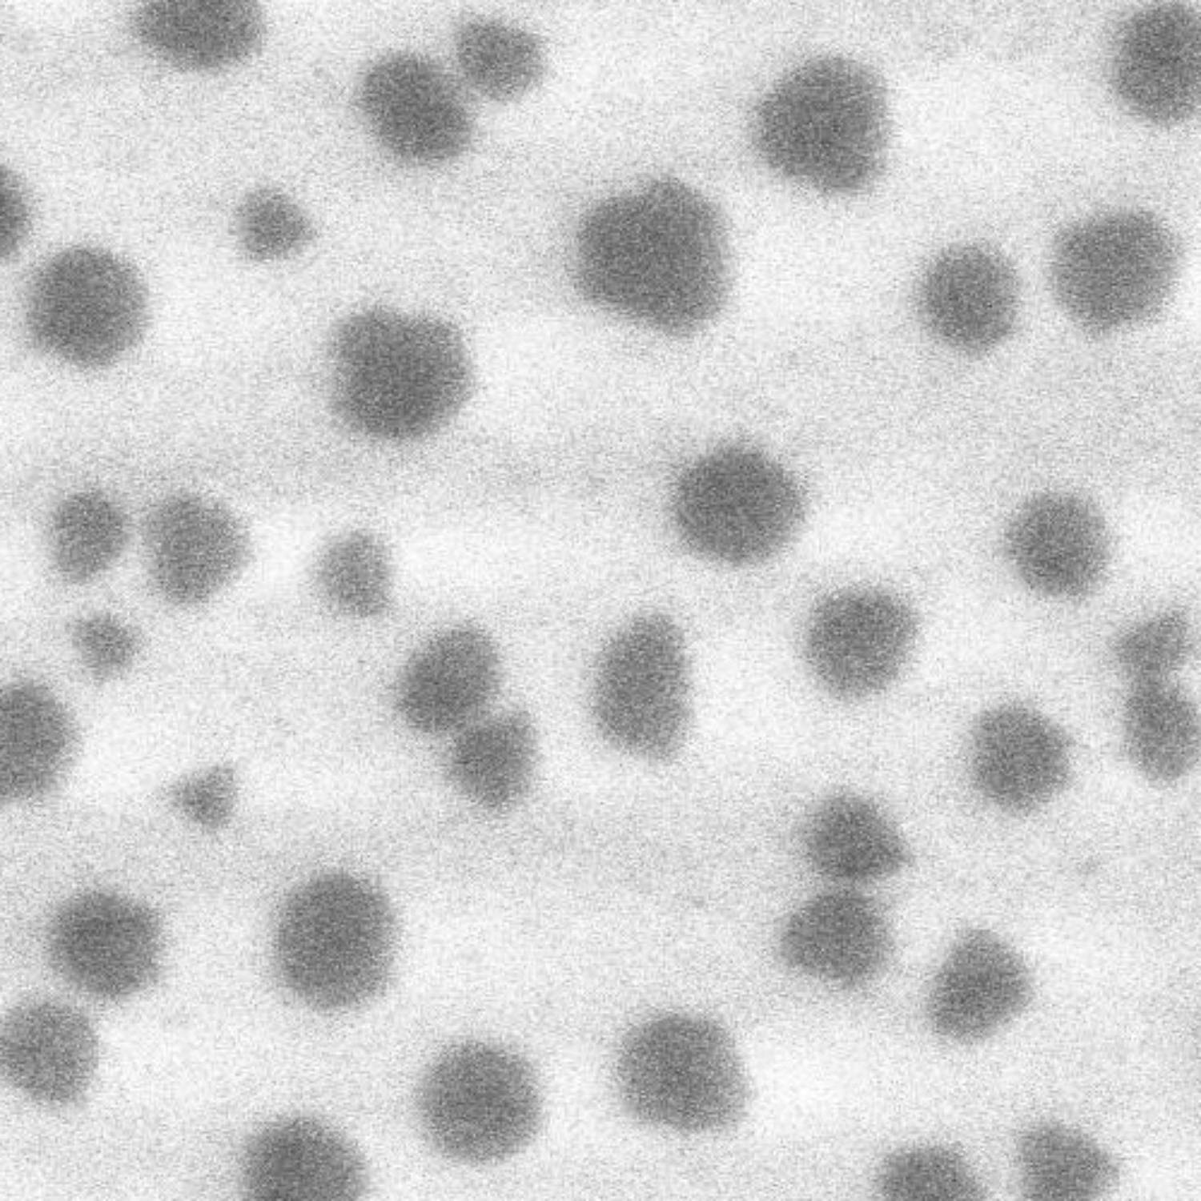
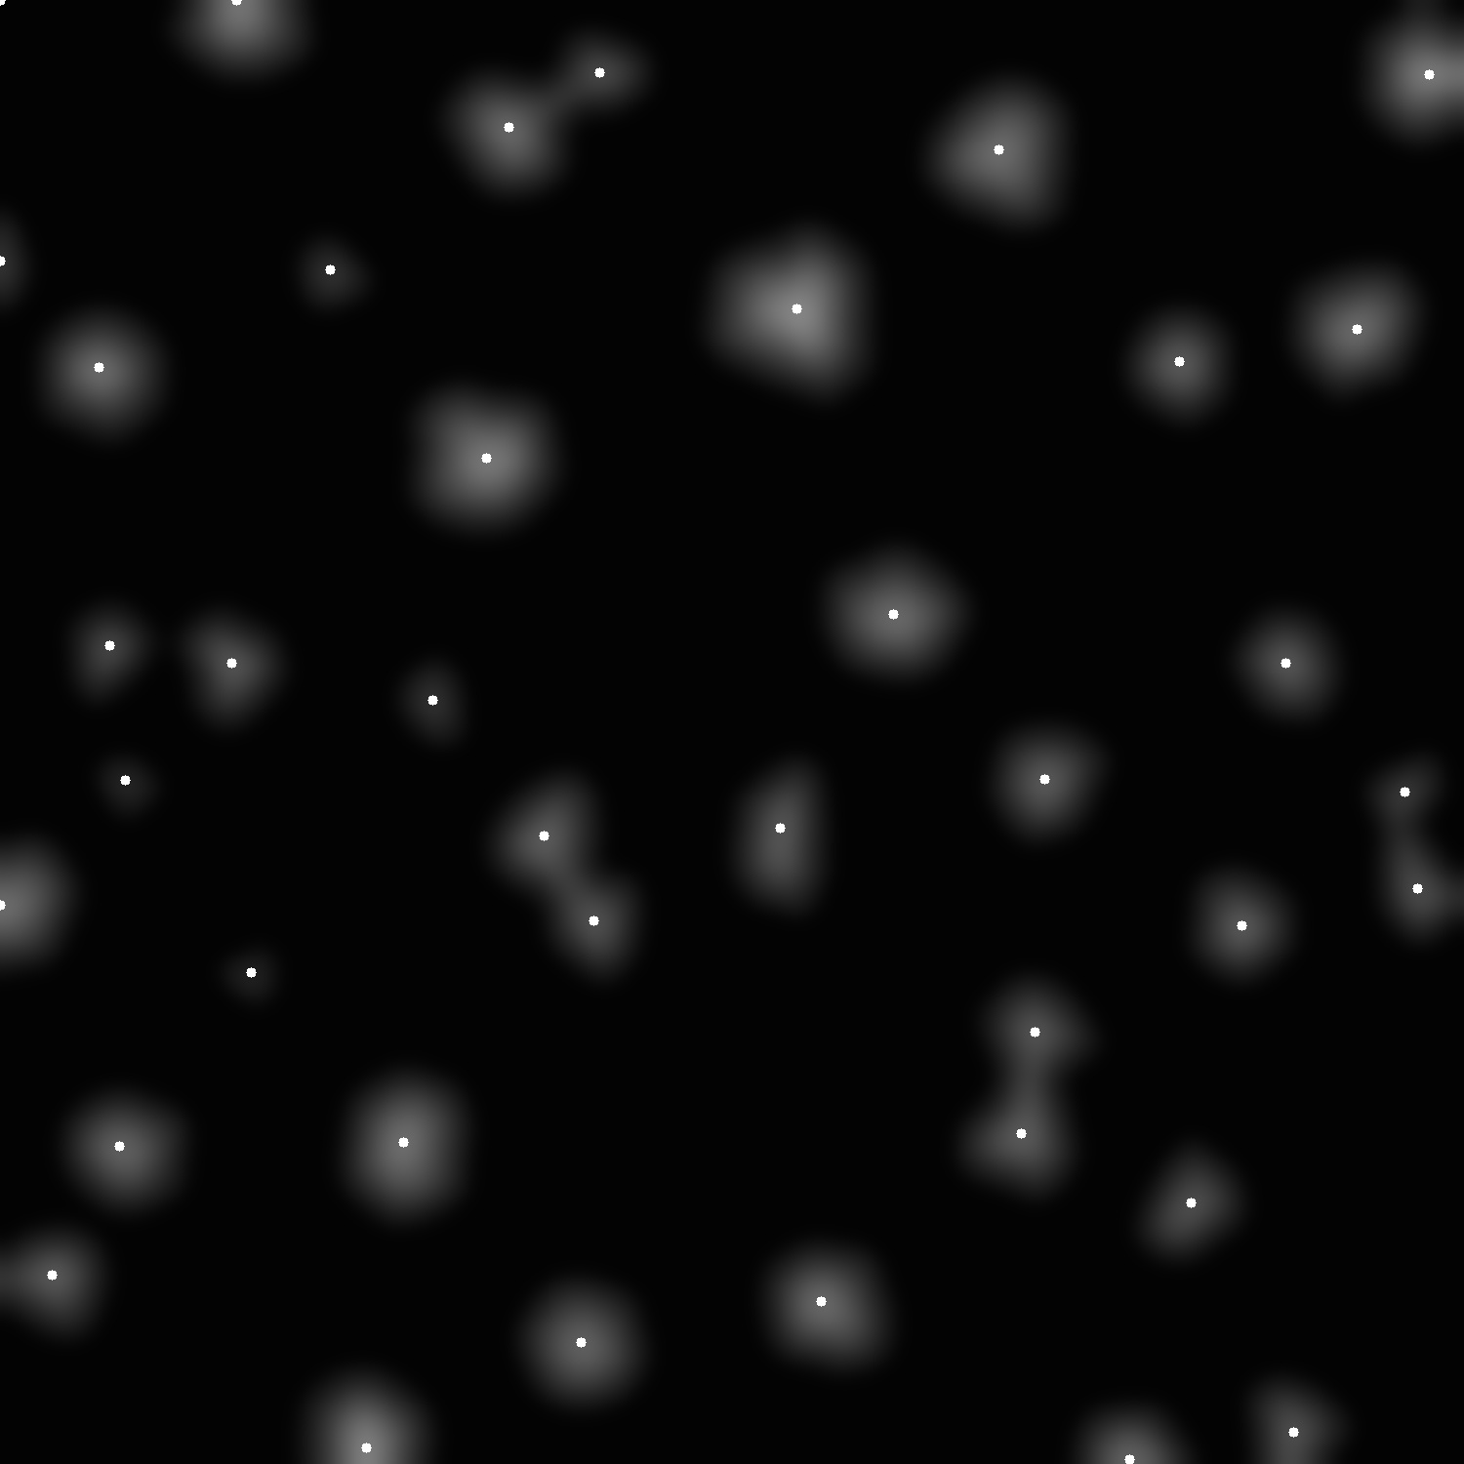
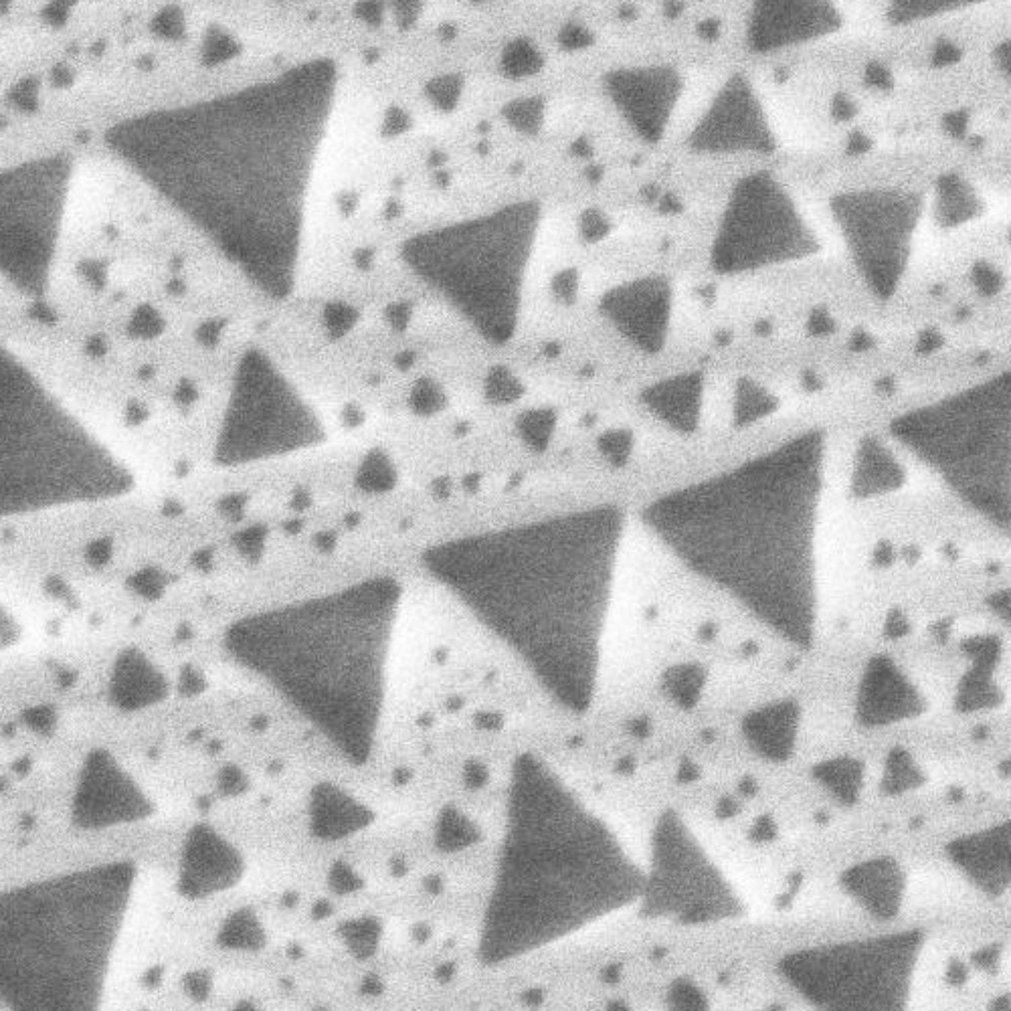

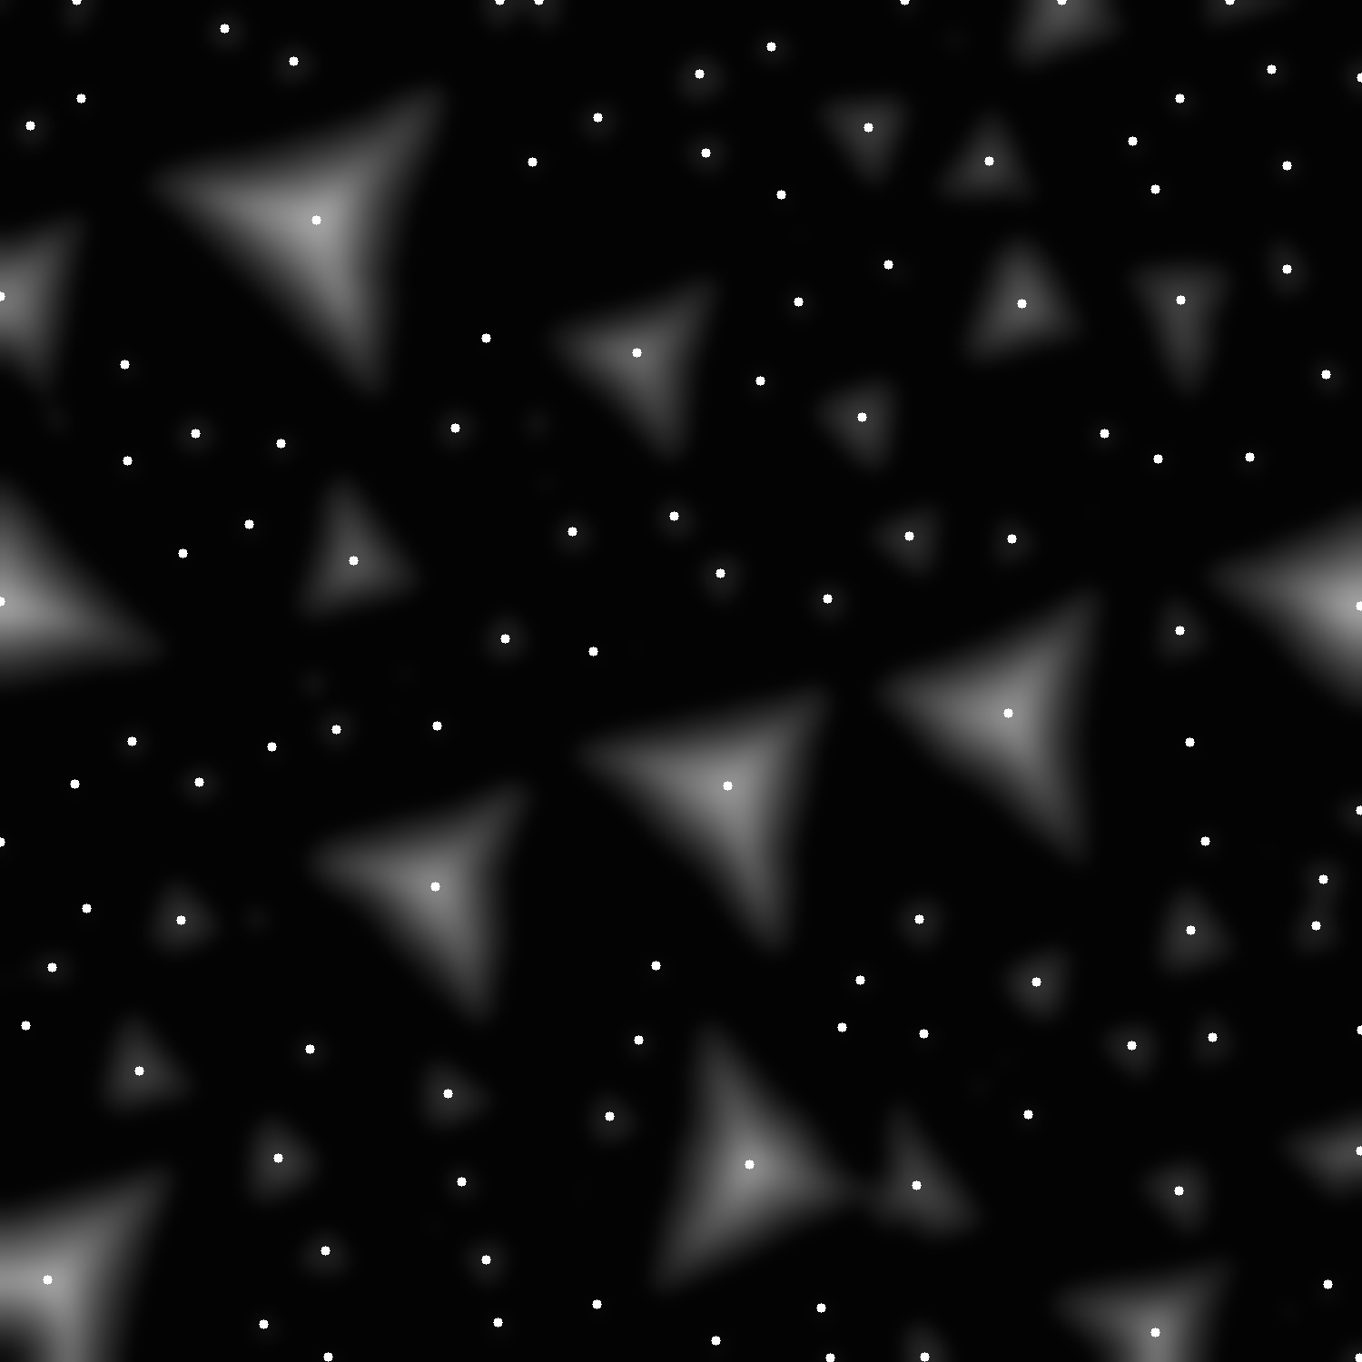
Watershed Improvement — Add foreground at local maxima
Dimension:3, 31.8
Position: 1, 0.5
Move a searching window through the image to find local maximum.
If a maximum is found, mark it with white, so that it will be recognized as a foreground (island) in the later watershed.
Original
After distance transform
Mark local maxima

Slide 16

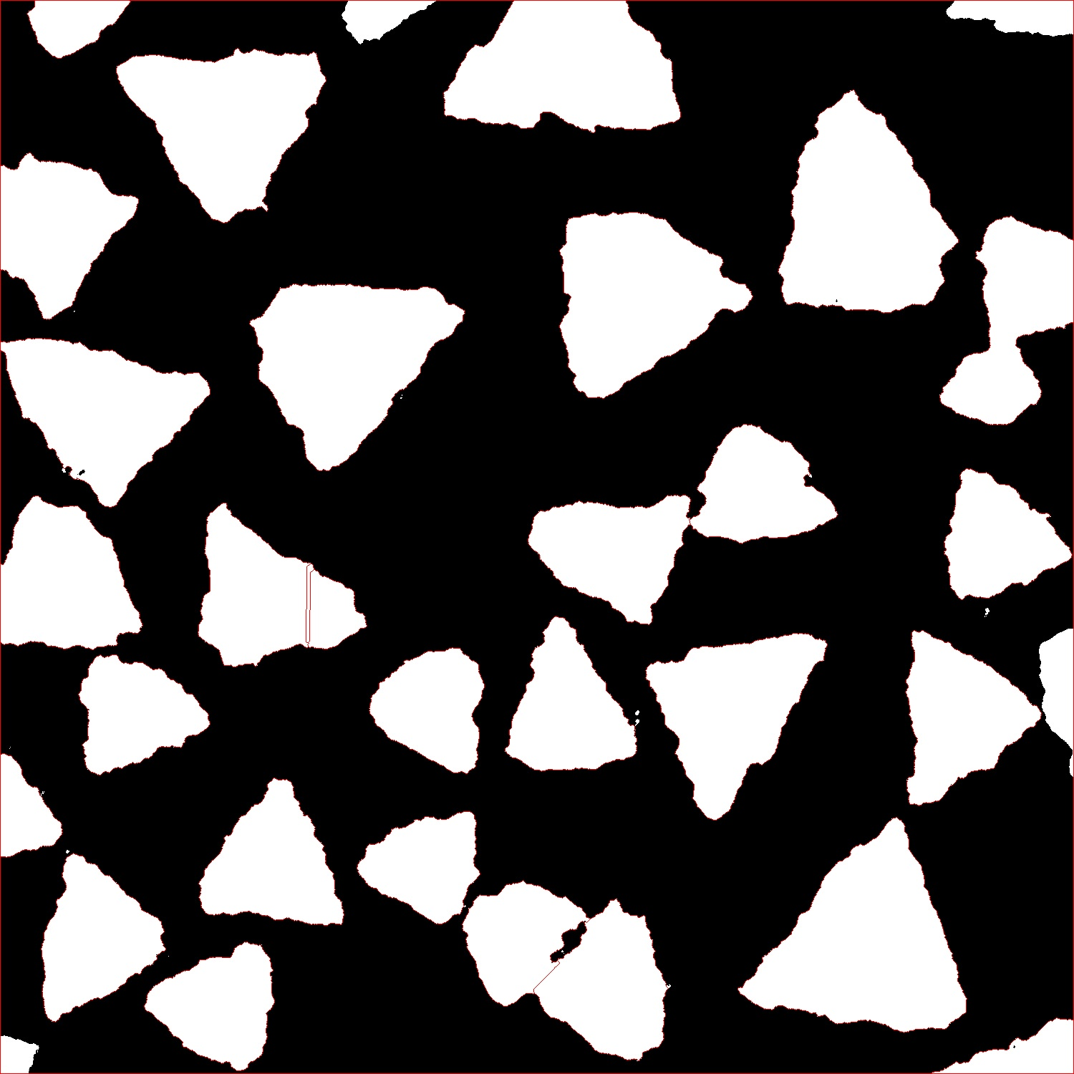
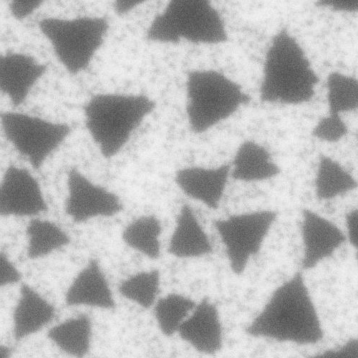

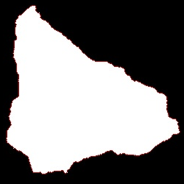
Foreground Sharp Edge Smoothing
Dimension:3, 31.8
Position: 1, 0.5
Some crystal have sharp edge that during foreground extraction, a single crystal will become multiple crystals, causing error in the later watershed.
Solution: Applied edge smooth to the extracted foreground, then proceed watershed.
Normal case.
This issue case.
Input
Foreground/Background overlay
Corrected result.

Slide 17
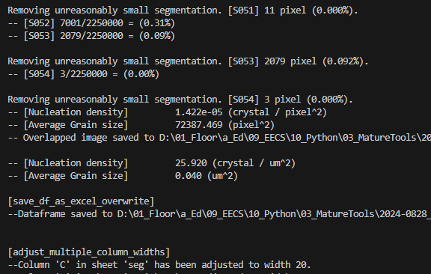
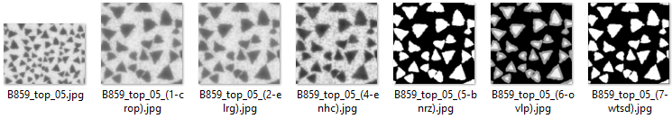

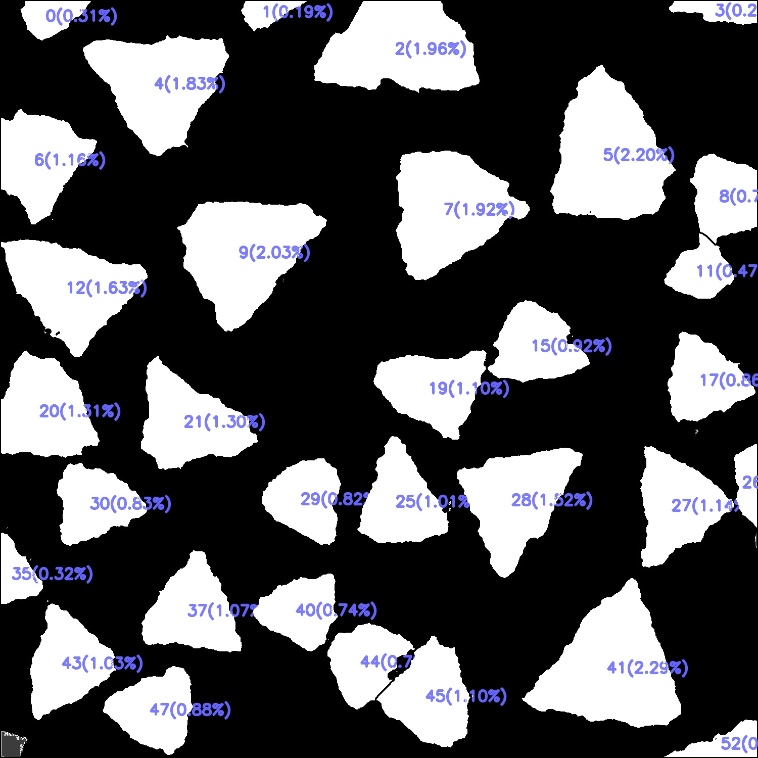
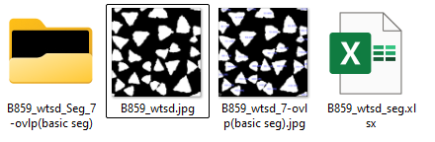
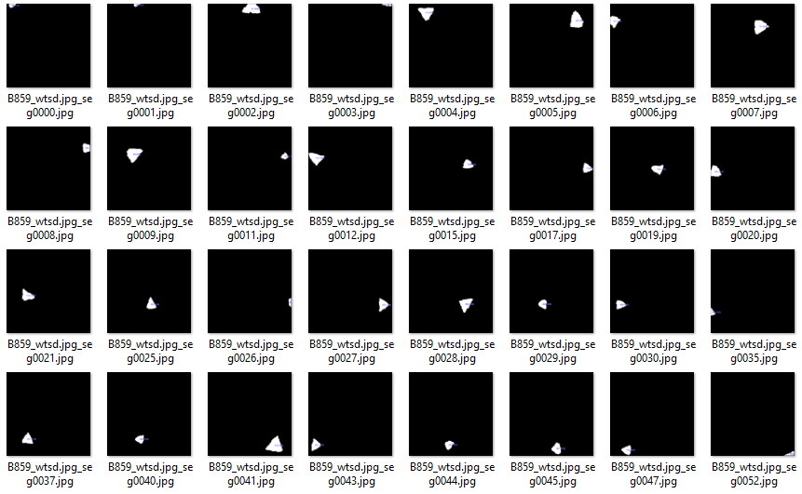
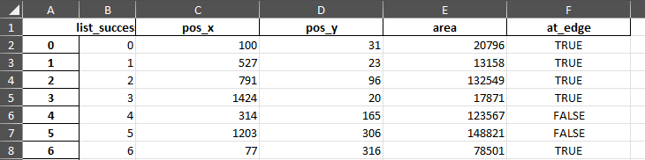
Dimension:3, 31.8
Position: 1, 0.5
Segmentation
Approach with more reliable traditional segmentation process.
Original
Gentle Blurred
Gentle Enhanced
Binarized
(a) Image process: Crop, enlarge, blur, enhance, and watershed.
(b) Before segmenting (last of image process).
(c) Segmentation result (layer by layer).
(d) Segmentation result (overlap).
(e) Precessing terminal
(e)
(a)
(b)
(d)
(f)
(c)
(g)

Slide 18
Future Work
Dimension:3, 31.8
Position: 1, 0.5
Improve the watershed function to better adapt to SEM images in various condition.
Obtain device data from Jiadi or Yixuan to correlate the numerical representations of SEM images with device performance.
Conduct literature research on the feasibility of using machine learning models to embed SEM images into dense array representations.
△
Recipe Optimization
Recipe
SEM Image Numerical Representation
Coverage calculation ✓
Scale mark extraction ✓
Average grain size calculation ✓
Nucleation density calculation ✓
Circumference calculation ✓
Background noise representation ✓
Synthesis
Sample
Characterization
✓
SEM Image
Computer Vision
Analysis
Fabrication
Device
Measurement
Prediction
△
Performance

Slide 19
Calibri Light, 32-36, Bold (H=2.8, W=30, x=1, y=0.5)
Calibri Light, 20-24 Normal
Dimension:3, 31.8
Position: 1, 0.5
Calibri, 16-24, Normal (H=13, W=30, x=1, y=3.8)
Calibri, 16-24, Normal (H=13, W=30, x=1, y=3.8)

Slide 20
Calibri Light, 32-36, Bold (H=2.8, W=30, x=1, y=0.5)
Calibri Light, 20-24 Normal
Dimension:3, 31.8
Position: 1, 0.5
Calibri, 16-24, Normal (H=13, W=30, x=1, y=3.8)
Calibri, 16-24, Normal (H=13, W=30, x=1, y=3.8)

Slide 21
512x512
128x128
32x32
8x8

Slide 22
Future Work
Calibri Light, 20-24 Normal
Dimension:3, 31.8
Position: 1, 0.5
Crystal Violet
Patent
Mobility data (B620 ~B640)

Slide 23
Future Work
Calibri Light, 20-24 Normal
Dimension:3, 31.8
Position: 1, 0.5
Crystal Violet
Patent
Mobility data (B620 ~B640)

